Slide 1


Open Access
What’s Happening?
Nia Wyn Roberts, March 2015

Slide 2

What is OA?
What is Open Access?
“free availability and unrestricted use”
Free online access to publicly-funded research, especially journal articles & conference papers
Open Access is about removing price barriers (subscriptions, licensing fees, pay-per-view fees) and permission barriers at the point of use.

Slide 3
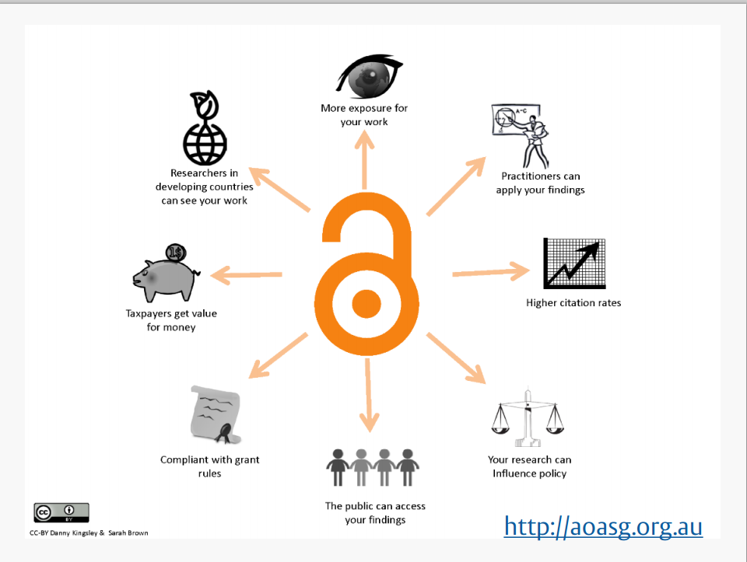
Notes:
.

Slide 4


Gold route
Immediate open access
No cost to user
Final published version
May need to pay an APC (Article Processing Charge)
Journal could be
  Fully OA
  ‘Hybrid’ (subscription journal with OA option)
Gold

Slide 5

Green route
Green
Publish in subscription journal.
  Deposit/self-archive the author accepted manuscript / postprint / in a repository
    Institutional e.g. ORA
    Subject e.g. PubMedCentral
  It goes OA after embargo period specified by publisher.

Slide 6









Funders with OA policy

Slide 7

RCUK Policy
Applies to peer-reviewed research articles:
  – that acknowledge Research Council funding e.g. MRC
  are submitted for publication from 1 April 2013
  are published in journals or conference proceedings
Articles must be published in journals that allow:
  – either immediate Gold OA with a CC-BY licence
  – or Green OA with after embargo period – 6 months for MRC
Articles must include:
  details of funding (incl. grant number)
  statement about access to underlying research materials/data
Reproduced with permission of Alison Sutton, University of Reading

Slide 8
NIHR Policy
Applies to peer-reviewed research articles:
  – that acknowledge NIHR funding
  are submitted for publication from 1 April 2014
  are published in journals or conference proceedings
Articles must be published in journals that allow:
  – either immediate Gold OA with a CC-BY licence
  – or Green OA with after embargo period – 6 months
Articles must include:
  details of funding (incl. grant number)
  statement about access to underlying research materials/data
Aiming for 100% compliance by 2017/2018

Slide 9

The Next REF
New HEFCE policy for Journal articles & conference papers accepted for publication after 1 April 2016
To be eligible for submission to the post-2014 REF, authors’ final peer-reviewed manuscripts must be deposited in an institutional or subject repository within 3 months of acceptance for publication.
They must then be OA within 12 months (A & B) / 24months (C & D)
Applies to journals and conference proceedings with an International Standard Serial Number (ISSN).
But NOT monographs, book chapters, or data.
HEFCE policy and University guidance are on our website.
OA Project exploring best way to get 100% deposit in ORA.

Slide 10
University OA
Statement
The University of Oxford is strongly committed to ensuring the widest possible access to research.
Our academics, researchers, staff and students must be free to publish in the journal of their choice, maintaining academic freedom.
Oxford Research Archive (ORA) was established in 2007. It provides a permanent and secure archive of our research and a means for institutional compliance with funders’ Open Access requirements.
The University favours, now and for the foreseeable future, open access by means of the Green Route.

Slide 11
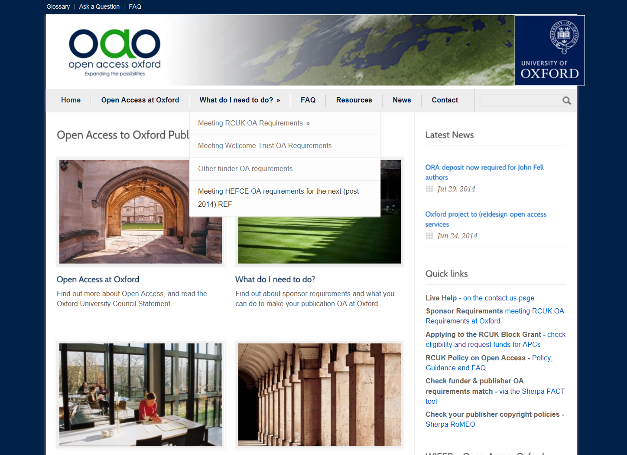
Website, Email, Live Help
/
http://openaccess.ox.ac.uk

Slide 12

Researcher Decision Tree – ‘Green’ or ‘Gold’?
How to meet the UK Research Councils’ requirements on Open Access
CHOOSE JOURNAL
Need help?
E: open-access-enquiries@bodleian.ox.ac.uk;
W: http://open-access.ox.ac.uk
Twitter: @oaoxford
GREEN OA PERMITTED BY PUBLISHER?
PUBLISHER OFFERS GOLD OPTION?
ORA COPY FOR PRESERVATION – ID/OA*
N
N
Y
Y
N
PUBLISHER OFFERS CC-BY LICENCE?
ORA – COPY FOR PRESERVATION – ID/OA*
PUBLISHER EMBARGO COMPLIES WITH FUNDER POLICY?
N
Y
ACCEPT GREEN EMBARGO WHERE PERMITTED
AND/OR
COPY IN ORA FOR PRESERVATION – ID/OA
APC FUNDS AVAILABLE?
Y
N
Y
GREEN OA - ORA AND/OR SUBJECT REPOSITORY
IMMEDIATE GOLD OA + PRESERVATION COPY IN ORA
* Immediate Deposit/Optional Access

Slide 13
Article Processing
Charge
An APC is a fee paid to the publisher to make an article free at point of access.
The cost of publication is moved from the reader (via subscriptions and pay-walls) to the author (via the APC).
Average APC = £1821 (+ VAT).
If APC paid, article needs CC-BY licence.

Slide 14

Creative
Commons Licenses
Alternative to Copyright Transfer Agreement
Author grants License to publish
    Author retains copyright
Types of licence: reuse of content?
  CC-BY (Attribution) - RCUK Gold
  CC-BY-NC (Noncommercial) – RCUK Green
  CC-BY-NC-ND (No Derivatives) - HEFCE
  See OAO Blog for more on CC-BY
http://creativecommons.org/choose/

Slide 15
Paying APCs
Include publication costs in grant application
  NIHR/DH
Get it paid for you upfront
  MRC
    Oxford got RCUK Block Grant £1.3 million for 2014-15
    Application form on OAO site
    Send with publisher’s payment request form to apc@bodleian.ox.ac.uk
Pay and apply for refund
  Wellcome Trust (allocates Oxford a central fund)
  Charities Open Access Fund e.g. CRUK, BHF
See OAO web-site http://openaccess.ox.ac.uk

Slide 16


Tools to help
Check JOURNAL policy on Sherpa Romeo
Check FUNDER policy on Sherpa Juliet
Combine them with www.sherpa.ac.uk/fact/
Directory of Open Access Journals
  9,804 fully OA Journals (excludes
  hybrids) http://www.doaj.org/
  If in doubt, consult open-access-enquiries@bodleian.ox.ac.uk

Slide 17
Example
NIHR researcher wants to publish a paper in British Journal of General Practice
Check SHERPA ROMEO for journal:
  There is an APC option (£1700)
  The journal doesn’t allow archiving
  Check BJGP web-site for further information
Check SHERPA JULIET
  Funder requires OA within 6 months– so you need to pay APC to comply
  Still Deposit in ORA with link to publisher

Slide 18
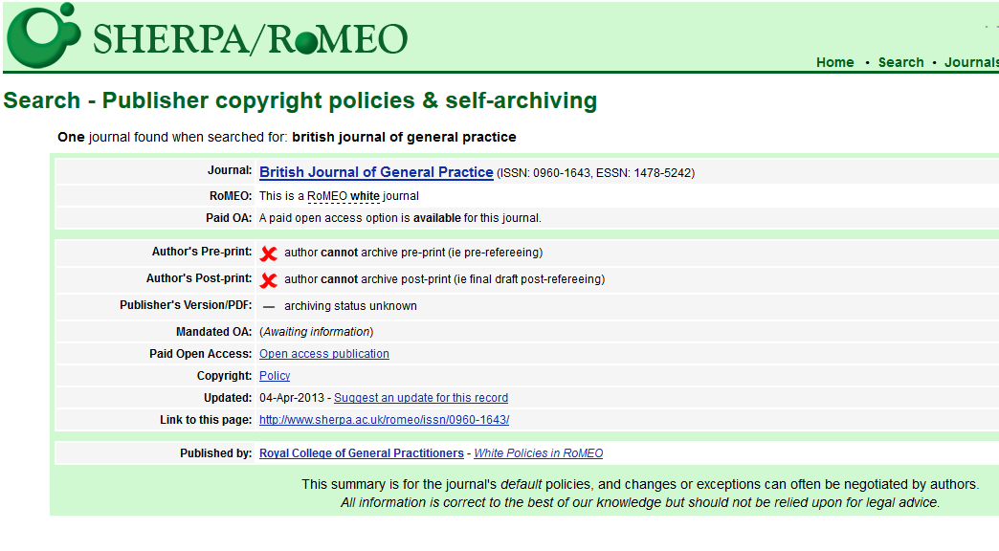
Sherpa Romeo
Green option
Gold option

Slide 19
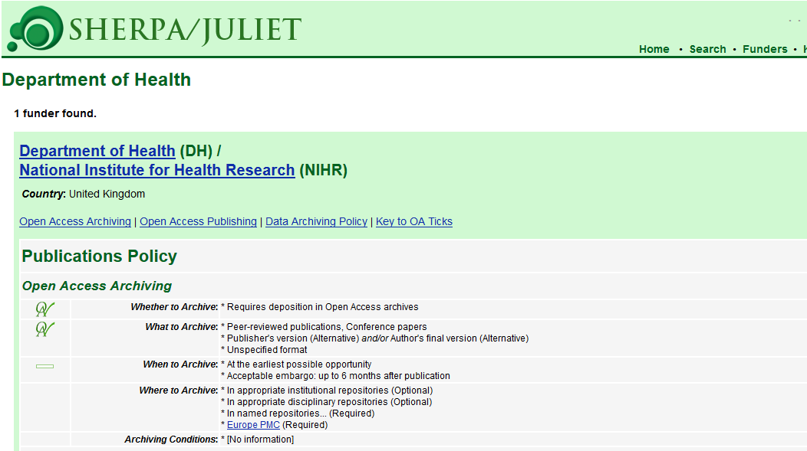
Sherpa Juliet

Slide 20
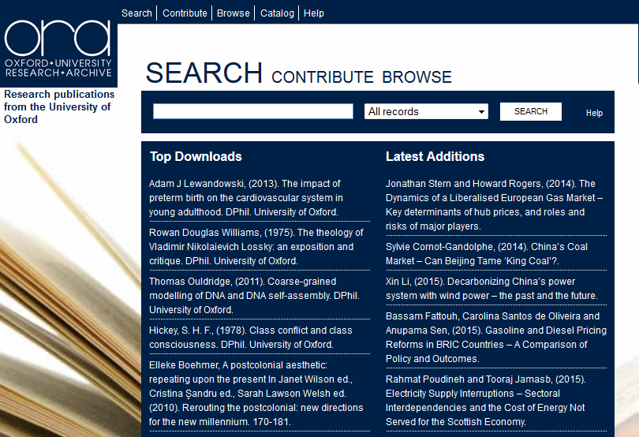
http://ora.ox.ac.uk

Slide 21
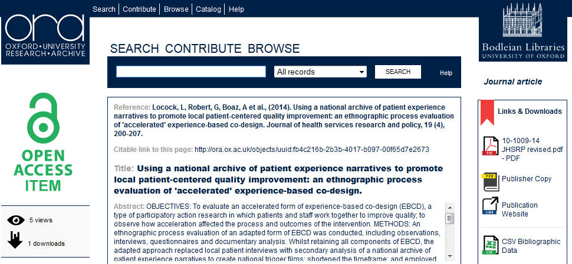
Submitting records to ORA

Slide 22
Get Help
Bodleian Libraries
Web-site: http://openaccess.ox.ac.uk
Helpline: open-access-enquiries@bodleian.ox.ac.uk
Keep up to date with Twitter: @OAOxford
Subject Librarian nia.roberts@bodleian.ox.ac.uk

