Slide 1
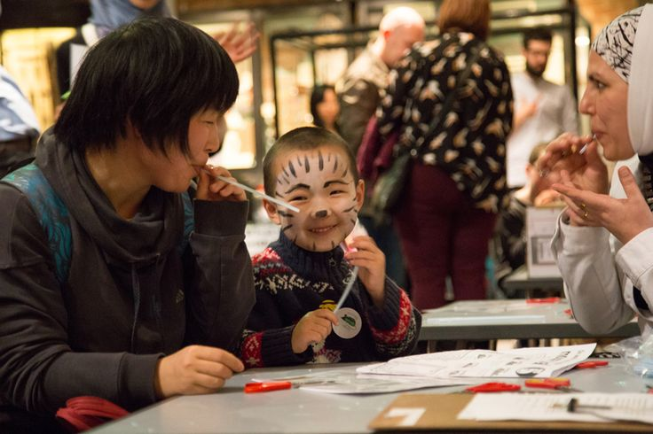
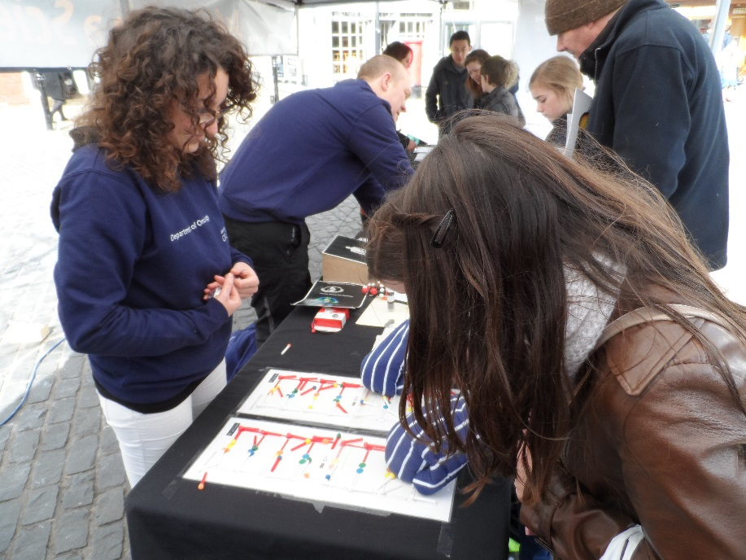
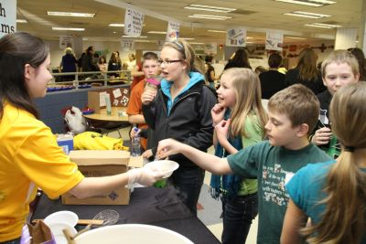
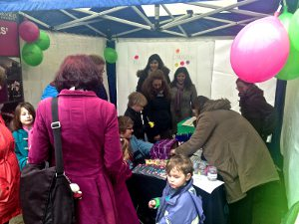
Top tips for presenting at an exhibition

Slide 2
Who are we talking to?
Town Hall:
Likely to be people already interested in science.
They may have their children with them and are looking for an educational/fun activity.
High Street:
A wide variety! Could be anyone. They may question our research or challenge us based on their own experiences of smoking cessation.
Some may have personal issues around our topic.
Assume our visitors are very intelligent – but not necessarily knowledgeable about the topic. Do not patronise

Slide 3
How to start a conversation
Don’t pounce! Think about how you like to be treated in a shop.
Ascertain your visitor’s interest to start with, ask them:
Have you come across this sort of research before?
Is this a particular interest of yours?
Do you know what these chemicals are?
Have you seen something like this before?
Would you like to play our game?
Don’t simply just give stuff away, make the visitor earn it.
If there are children, go straight for the make and take activity.

Slide 4
You are performing and facilitating, not presenting
This is about trying to have a conversation, our activities are prompts.
Remain calm and relaxed. Speak slowly.
Try to establish some rapport
Be confident, do not read off the sheet. Remember some facts and figures.
Keep your answers jargon free
Develop a short patter for your activity – but try to tailor it to the person your are speaking to.

Slide 5
What questions will we get asked?

Slide 6
What is the value of this research?
Why isn’t this money being spent on treatment?
What are the implications of our research?
How do we get this research into practice?
Where is the toilet?

Slide 7

Do:
Assume visitors to be intelligent
Remember our visitors may be hesitant in engaging us in conversation – they don’t want a lecture.
Put our visitors at ease.
SMILE! Be pleasant and welcoming. We are not selling
Treat visitors with courtesy and respect.
Remember that some of our visitors may have personal issues around the topic.
Let people move on.
Behave appropriately with children.

Slide 8

Don’t:
Sit down at the stand
Stand with your arms folded
Just talk to colleagues
Pounce on each visitor, chose your moment carefully.
Eat and drink on the stand, it looks unprofessional.
Force material onto people
We don’t want all of you stood behind the table – walk around it. The table acts as a barrier.

Slide 9


