Slide 1
Research strategy
Evidence and innovation in primary care
Richard McManus
Chair – Department Research Committee

Slide 2
Why do we need a research strategy?
The department has grown organically.
We need to focus on our strengths while identifying and nurturing new areas of interest.
We need a clear national and international profile and to be more vigilant to the shifting external landscape/national priorities.
It is important to ensure each research group is included in departmental priorities.

Slide 3
10 new research themes
The new research themes are a broad representation of what we do.
Consist of:
  Five key research themes
  Five cross-department themes
Aim to galvanize understanding of our key strengths – both internally and externally.

Slide 4
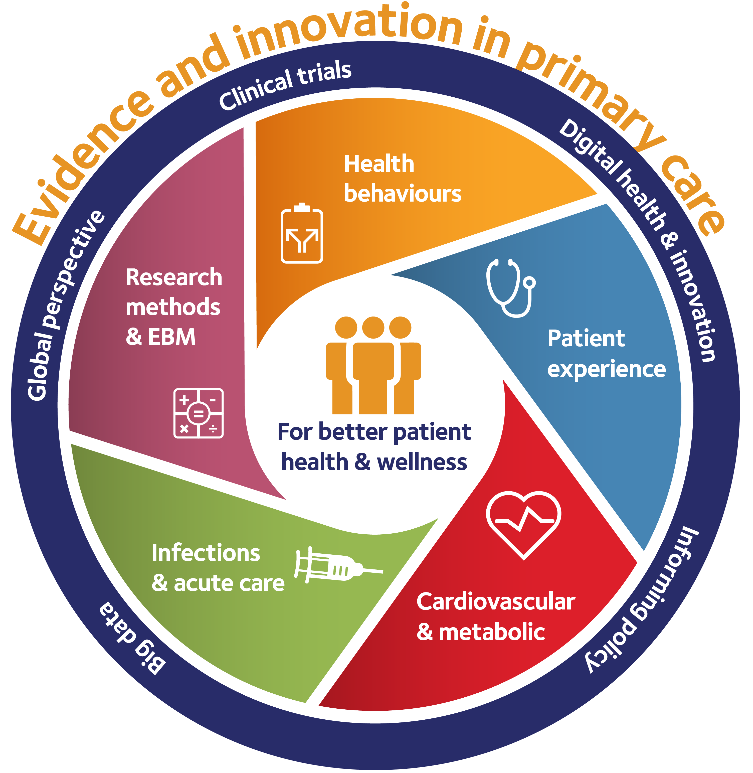

Slide 5
Inclusive approach
The strategy has been developed through consultation with heads of research groups.
Each research group fits into at least one theme – we don’t intend to leave anyone out.
The themes leave room for growth in emerging areas, (big data, pregnancy).
They demonstrate the multi-disciplinary nature of our work.

Slide 6
This is an evolving mix
of themes

Slide 7
The vision: Fewer, bigger, better studies
Themes will be encouraged and supported to develop proposals for ‘Unit’ or ‘Centre’ status.
Emerging research areas will be nurtured.
The strategy is dynamic not fixed

Slide 8
The vision: Fewer, bigger, better studies
The Research Committee aims to:
Support our methodological researchers.
Assist professional development and training.
Identify new collaborations and sources of funding.
Drive forward pathways to impact.

Slide 9
The path to REF 2020
We will do a practice REF this autumn.
This means identifying outputs – publications and impact
Trish Greenhalgh is leading work on supporting impact in the department.
We all need to get better at telling the story of research impacts - ongoing rather than every five years.

Slide 10
Thank you – any questions?

