Slide 1
NDPCHS Social Media – Overview and Guidance
December 2024

Slide 2
Contents
Why does NDPCHS use social media?
What social media channels does the department use?
What are the department’s social media channels?
What are the key benefits of using social media (for researchers)?
Social media best practice – tips and tricks
Further guidance and links
Notes:
It is important to note that this presentation should serve as guidance for social media practice. Social media is dynamic and constantly changing, and so best practice is often shifting. For full guidance on social media at the University of Oxford, including read PAD’s social media guidance (including section pages 17-22 on 'social media community management' covering dealing with criticism and trolls, and wellbeing).

Slide 3
Purpose of social media
Social media is an integral part of our overall communications. It:
  Supports the department’s business goals of: research; teaching and training; people and culture, and development.
  Helps raise awareness about activity in the department, building and supporting our reputation as leaders in the field.

Slide 4
NDPCHS social media channels
Channel | Purpose | Use case
LinkedIn | Ideal for professional networking, sharing research findings, and promoting academic achievements. Well suited to posts about recruitment and community engagement. | Share more detailed insights from research Highlight departmental and individual achievements (eg staff, students, and researchers) Connect with alumni and current students Run targeted paid advertising campaigns for postgraduate programmes Amplify student/staff voices where appropriate
Bluesky | Ideal for quick updates, sharing news, and engaging in conversations with a broad audience. Well suited to dissemination of research findings and departmental news. . | Share links to new publications and research outputs Live-tweet events Connect and engage with other researchers, institutions, and stakeholders Promote postgraduate programmes Retweet activity related to the department
YouTube | A channel for in-depth content such as lectures, interviews, and informational videos. Could in time expand this to utilising YouTube shorts, depending on video creation project. | Share long-form video content from lectures, seminars, and other departmental events Store marketing videos related to postgraduate programmes Save unlisted research videos
Channel(s) no longer actively in use by NDPCHS
Twitter (X) | NDPCHS is ceasing active posting on X (formerly Twitter) due to growing concerns over declining engagement from our audiences and platform governance. | Our central @OxPrimaryCare account on X will remain accessible for historical content. Individual twitter accounts can be useful for quick updates, sharing news, and engaging in conversations with a broad audience. Find information on using X from the University’s Public Affairs Directorate.
Notes:
These are the social media channels the department currently uses. Please note that personal use case of these channels may differ to the department’s use case.

Slide 5
NDPCHS social media accounts
Channel | Main department channel | Other channels
LinkedIn | Nuffield Department of Primary Care Health Sciences | The Centre for Evidence-Based Medicine NIHR ARC
Bluesky | Nuffield Department of Primary Care Health Sciences (@oxprimarycare.bsky.social ) | The Centre for Research Equity (@thecfre.bsky.social)
YouTube | Oxford Primary Care @OxPrimaryCareSci | The Centre for Evidence-Based Medicine @cebmoxford6066
Twitter (X) | No longer in use: Nuffield Department of Primary Care Health Sciences (@OxPrimaryCare) | The Centre for Evidence-Based Medicine (@CebmOxford) Oxford Postgrad: EBHC (@OxEBHC) NIHR ARC (@arc_oxtv) NIHR (@NIHR_CH_MIC) The Centre for Research Equity (@TheCfRE)

Slide 6
Key benefits of social media (for researchers)
Enable effective research dissemination
Connect with like-minded people who share your research interests
Gain valuable insight around research topics of interest
Keep abreast of discussions and conversations related to research topics
Notes:
Social media channels allow you to effectively disseminate and promote key research and important health messages with relevant audiences who you might not otherwise have access to. They provide a platform for you to advocate for research and augment your research contributions in your field of interest, as well as enabling you to amplify your reach of target audiences by building a network of likeminded individuals, groups and organisations.
Building connections with relevant people with shared interests, who resonate with your content is important as it invites two-way engagement. Not only are you providing useful, relevant, content for your target audience, but they can also do the same for you. Because of this mutual benefit, they are more likely to engage with your content, thus improving your credibility and increasing your reach of your key audiences.
Example: If an organisation within your field of interest shares one of your posts, this automatically reaches the followers/connections of that organisations, many of which may be relevant to you as well, increasing the likelihood of attracting more relevant engagers!
When you engage with the right people, relevant to your field of interest, you gain valuable insights around what your engaged audience looks like, which messages and topics they resonate with most, you gain access to similar content and research that might help challenge or consolidate your findings and can even elicit a constructive conversation. Equally, you are able to keep abreast of real-time key conversations related to your research topics of interest.

Slide 7
Engaging header: What is the key message/finding and what does that mean for your audience?
Use stats and quotes
Coincide messages with topical industry news
Include alt text for images
Include links
Have a clear call to action
Ask questions
Engaging posts
Post frequency matters
Use imagery to convey key message and evoke emotion
Keep it short and snappy
Use hashtags and @mentions
Get inspiration from high engaging posts of others
No jargon or acronyms
Make it personal
Notes:
The more engaging your post is, the more likely you are to build connections, and amplify the dissemination of your content. This slide includes an overview of key tips on what a great post might look like.
Engaging header: The header is the most important part of your post – in a sentence it should highlight the key message behind your research and allude to what that means/might mean for your target audience, i.e. why they should care.
Coincide with topical industry news: This adds credibility to your research and validates its relevancy.
Use stats and quotes: Using stats is a quick win for highlighting something that’s either really good, or really bad. They’re easy for readers to digest, they highlight key research findings and consolidate key messages. Quotes are great for adding a personal tone to your posts and authenticating your work.
Ask questions: Questions are a great way of personalising your message and eliciting engagement, like feedback or further discussion.
Include links: Social posts are obviously very short so adding links to a research paper/publication/website where people can access more information to consolidate your findings is a good idea and means your research is getting the attention it deserves! LinkedIn also gives you the option to add a document where you could actually share a white paper or an article or something you’ve written so that the whole piece actually sits in LinkedIn
Use imagery and graphics: Tweets with images get 313% more engagement, 82% users watch videos on Twitter. On Twitter and Bluesky you can attach up to four photos. LinkedIn currently allows up to 9 photos. Images can combine an image and a key message, bullet points or quotes to help tell the story and without using up characters in your post. You can also tag people who are either in the photo itself or part of the research you’re discussing– it doesn’t use up your character count and means those people are likely to reshare the post.
A graphic can include further important information about your research, including stats, bullet points or quotes, and doesn’t use up any of your word count!
Include alt text: If you are including an image or images in your post, it is best practice its good to include alt text for accessibility – this explains the content of the image for anyone using a screen reader. ChatGPT is a good tool to use for creating alt text quickly.
Make it personal – Speak directly to your audience, ‘you’, ‘your’. Add photos of ‘real’ people. Not just professional image library images. Post about real things as well: a quick win that you’re excited to share. At an event? Share a picture of it. Give recommendations and advice. It’s a balancing act between academic and emotive.
Use hashtags and @mentions (although in moderation): Hashtags make it easy for people to find content that is tailored to their clinical and research interests. They are a way to connect social media content to a specific topic, event, theme or conversation because on LinkedIn, Bluesky and X/Twitter, hashtags aggregate all social media content with that same hashtag. Therefore, using hashtags are likely to increase engagement and therefore your reach.
You can also check out posts and hashtags used by other groups to see what resonates and engages similar audiences. Do limit hashtags to two or three per post.
To increase credibility and reach of target audience, @relevant groups and networks if they’re relevant/associated to the post where relevant to increase engagement with your post and account. This means that the people you tag are likely to reshare your post with their relevant networks. Working on a funded project? Make sure to highlight those funders! Working in partnership with other organisations? Make sure to @mention them.
No jargon or acronyms: Don’t limit your audience unnecessarily. Balance informative research findings with informal/conversational wording. You want your message to be understood by everyone, not just those in the clinical world.
Keep it short and snappy: Most tweets will now fit 280 characters (from 140) and Bluesky posts can be 300 characters, whereas posts in LinkedIn can be up to 3000 characters long, including hashtags. Shorter posts typically perform better; however, if you are going to have a longer post, make sure to use line breaks for easier reading. Generally, all you need is your key message, what it means for your reader and a call to action.
Clear call to action: Think about what you want your audience to do. Do you want them to follow a link? Visit a web page? Download a paper? Sign-up for an event? Complete a survey? Make it clear. ‘Interested? Sign-up here’, ‘Access the full story here:’, ‘Follow this link for further details’, ‘Find out more’, ‘see here for guidance:’

Slide 8
Further guidance on hashtags, tagging, and tone
Hashtags | Tagging | Tone (from PAD Guidance)
Use up to three hashtags More than three hashtags may flag your post to LinkedIn as spam Capitalise each word in your hashtag for accessibility (eg #HealthLeaders) | Tagging can increase your engagement Do not tag more than 5 people/companies If you want to tag more individuals, tag them in the comments so that LinkedIn doesn’t flag your post as spam | Be friendly, helpful and informative Don’t be afraid to make the odd joke! Define acronyms when you use them

Slide 9
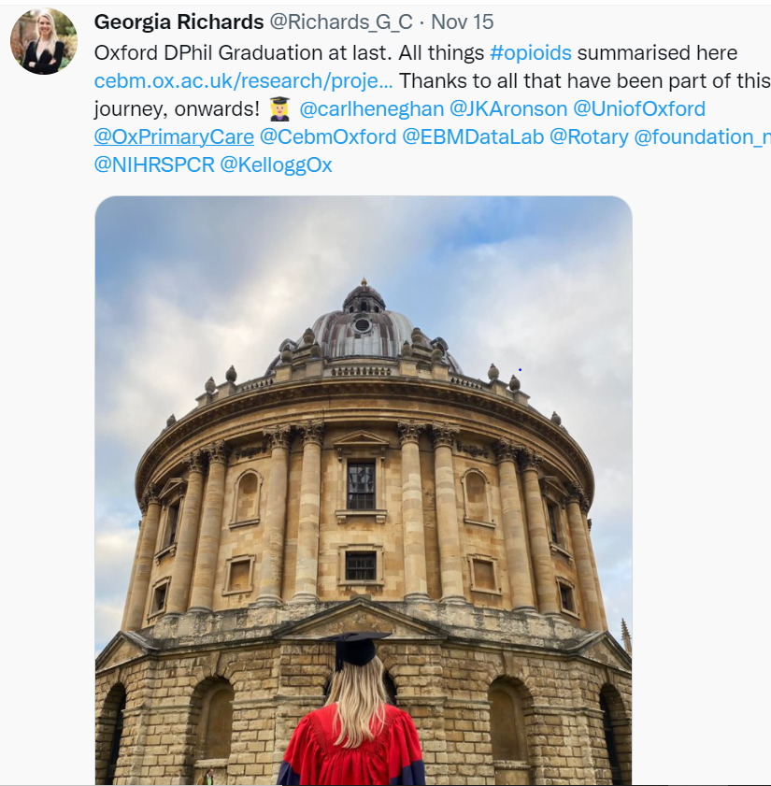
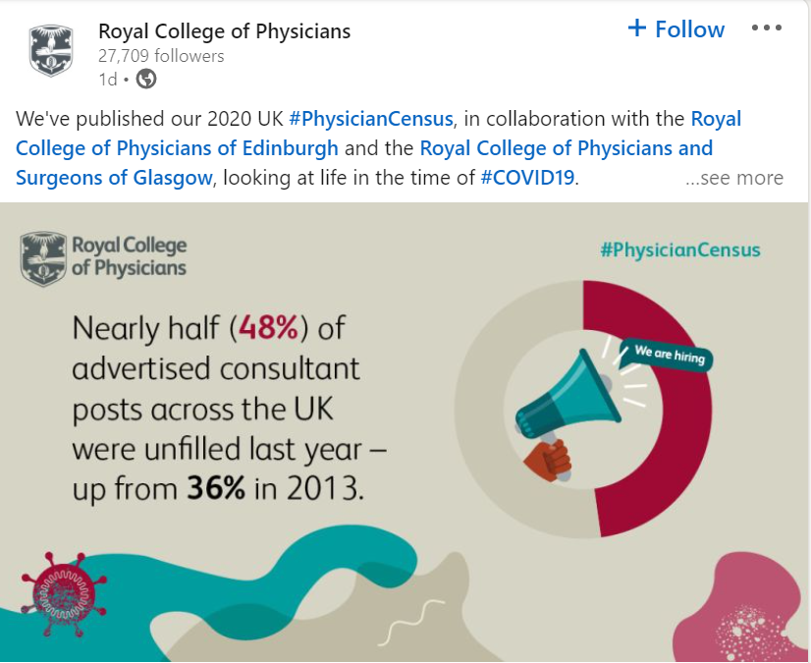
Examples of effective social media posts

Slide 10
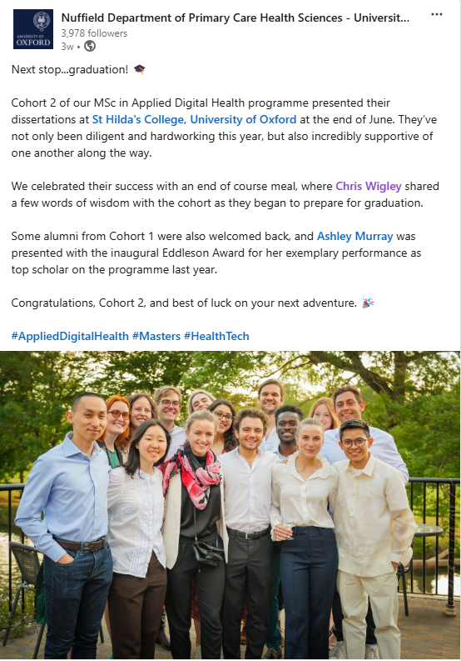
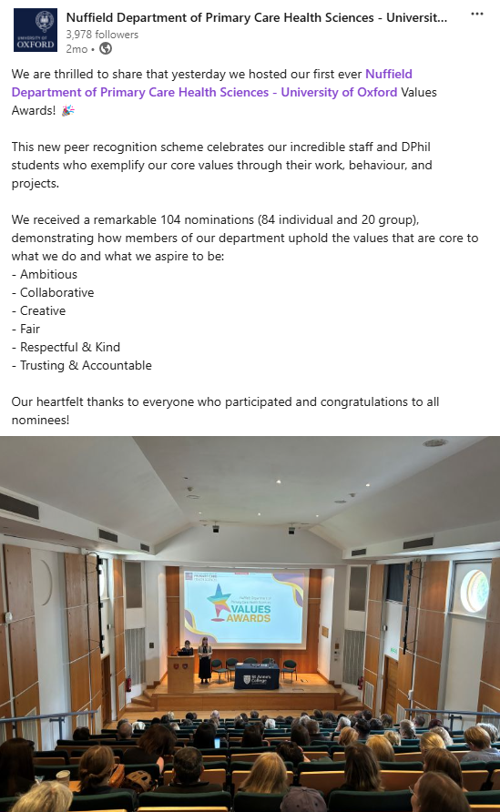

Slide 11
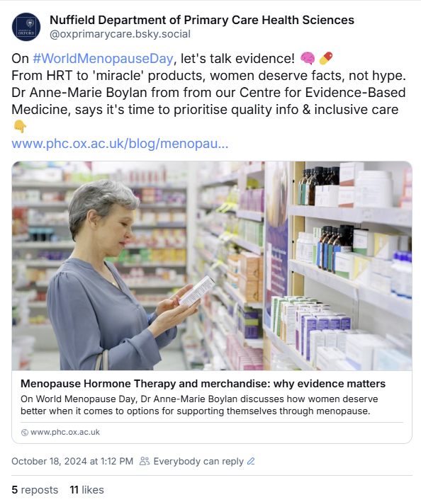
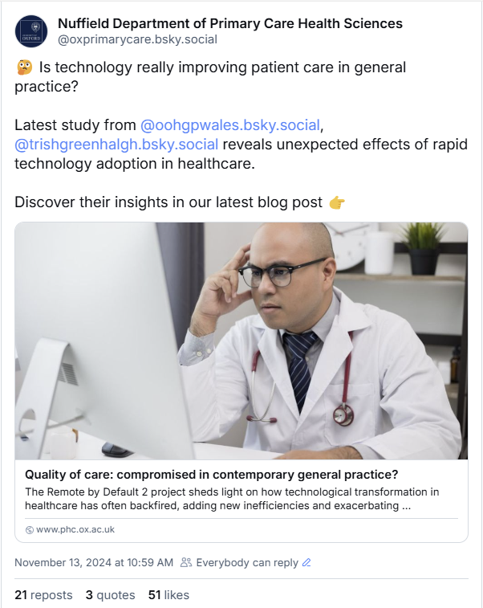

Slide 12
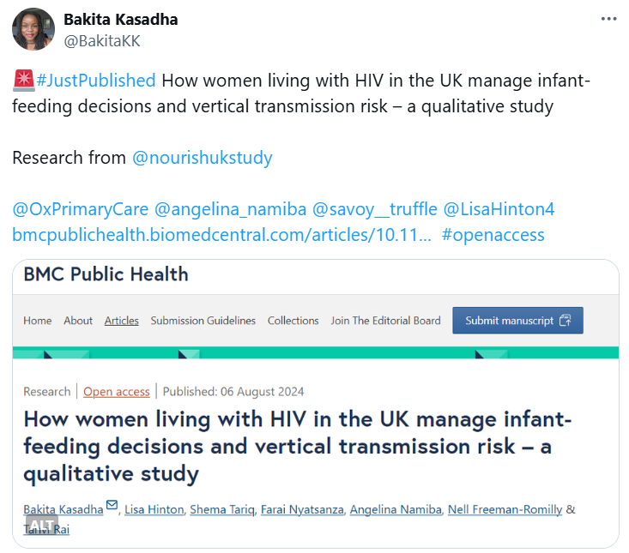
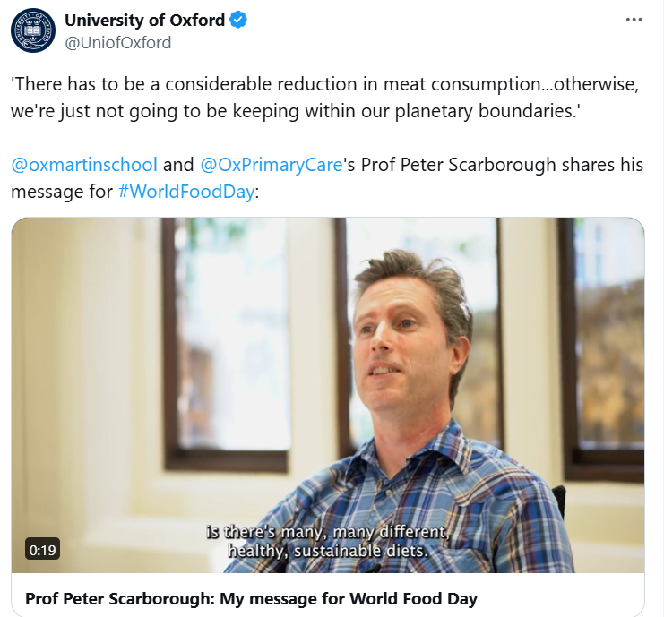

Slide 13
View connections/followers of people you are following and also see who they follow on Bluesky and X/Twitter, to find new, relevant people to engage with
Use the search bar to connect with or follow networks, groups, organisations and individuals who are relevant to your field of research
Comment on, share, repost, like, quote posts of others that are relevant to your research
How can I build connections with the right audiences?
View an individual's list of connections, influencers, companies and groups on LinkedIn to amplify reach of key audience
Make use of Bluesky’s starter packs, X/Twitter’s follower suggestions and LinkedIn’s ‘other people also viewed…’
@mention other groups/networks/individuals where relevant
Notes:
How can you build connections with the right audiences?
You’ll want to follow (or like) key networks, groups and organisations relating to your research. So think about who the key players are in your research topic? Perhaps your research involves other people within the University, in different departments and/or involves partnerships with other organisations? Give them a follow! Alternatively, you could speak with your supervisor, they will be able to recommend some key accounts for following. Once you’re following some relevant accounts, you can then see who they are following and who is following them, (Bluesky and X/Twitter only), giving you more potential applicable accounts to follow. You can also search relevant keywords and hashtags to help you find posts and accounts that have used those search terms.
Although you can’t see follower lists of others on LinkedIn, you can see an individuals list of connections, influencers, companies and groups as a way of scouting out new and relevant accounts to follow.
As mentioned in the previous slide, by @mentioning groups and networks you’re working with or who might be interested in seeing your posts, your ensuring that those groups see your posts and therefore as more like to reshare your content on their own accounts, maximising potential reach of target audiences.
X/Twitter also offers follower suggestions based on the accounts you’re already following and when looking at groups and networks on LinkedIn, it flags up other, similar accounts that others are following – a good way of finding like-minded people with similar interests. Bluesky has ‘starter packs’ and ‘feeds’ which show accounts and posts grouped by topics. Find out more on the next slide.
Share relevant, informative and engaging content by sharing/ sharing with a quote (Bluesky), retweeting/retweeting with a comment or sharing (LinkedIn). By promoting similar research from others, you are actively engaging with them which can encourage them to do the same with you, whether it’s through a follow, comment, or reshare. Resharing is the most important because it means relevant audiences are amplifying the reach of your research with other relevant audiences, and so the cycle continues. Gaining followers from key players in your field also increases credibility.
By sharing content of others you are adding credibility to your own research because you can use it to consolidate your own findings and are showing that you are actively keeping up-to-date with key industry topics.
Note: Individuals are often more likely to follow back than institutions.

Slide 14
Who to follow on Bluesky
Starter packs are lists of accounts, grouped by topics they frequently post about. You can easily choose to follow all users in a starter pack by clicking the ‘Follow all’ button.
  Use the searchable directory of starter packs
  Try: Primary Care Starter Pack, Trusted UK Doctors & Healthcare Voices, Healthcare Communication
  Can’t find the right starter pack for you? Create one under the ‘Starter Packs’ tab on your profile.
Feeds are curated collections of posts group by a certain topic, often based on a hashtag or an emoji, or created by users.
  Find new feeds in the main menu and check up on feeds you follow via the tab on your profile.
  Try: #AcademicSky, Digital Health, Qualitative Health Research, GP and Primary Care

Slide 15
Additional tips & tricks
Use URL shorteners
Use ChatGPT for alt text creation
Pin important posts to your profile
Reply to all comments on your posts with at least four words
Post no more than once a day on LinkedIn; however, Bluesky and Twitter/X welcome at least one post per day
Notes:
Because characters are limited on Twitter/X, using URL shortening tools can be helpful. Popular URL shorteners are bit.ly and tinyurl, which can reduce the link's character count to under 20 characters.
Note: once the link has loaded in your draft Bluesky post you can remove it from the post text.
Pin important posts to the top of your feed, i.e. latest research/post relating to a key project you’re working on so that it gets more awareness.
The more you post and interact, the more the social media channel rewards you. It can tailor your experience, i.e. recommend your account to others who follow similar accounts.

Slide 16
Royalty free image libraries
Unsplash
Pixabay
Pexels
Flaticon – for icons

Slide 17
Best free tools for creating social media graphics
Canva
Adobe Spark
Pablo by buffer

Slide 18
Further guidance
Communications Intranet
Social media guidance for academics
PAD social media guidance

Slide 19
Questions?
communications@phc.ox.ac.uk

