Slide 1
NDPCHS Christmas Party
Save the Date!
19 October 2023

Slide 2
This year’s theme is…

Slide 3


Slide 4

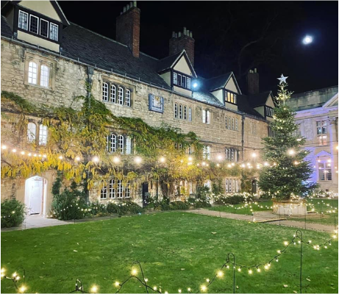
When: Friday 8th December 2023
Time: 7:00 pm until midnight
Venue: Teddy Hall
(St Edmunds Hall)
Queens Lane, Oxford

Slide 5
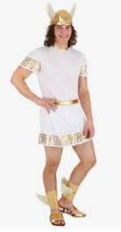
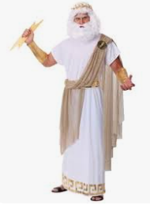
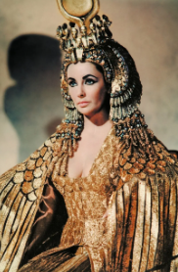
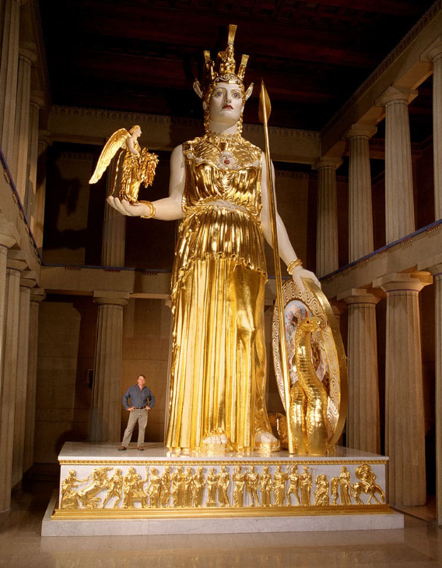
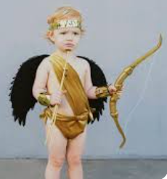
Gold Gowns & Crowns
Hermes
Zeus
Glam Cleopatra
Athena Swan
DIY budget idea

Slide 6
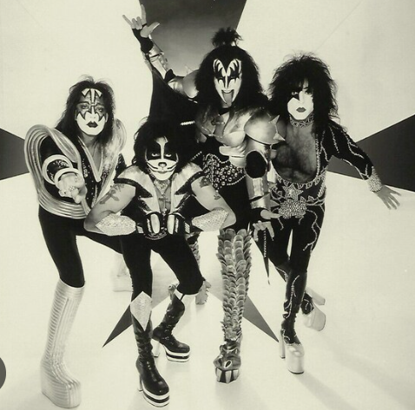
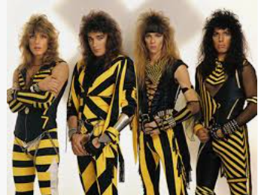
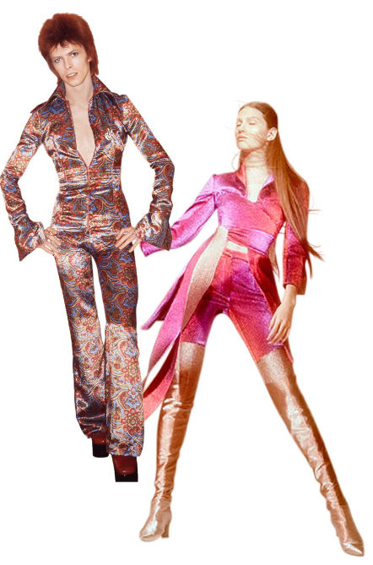
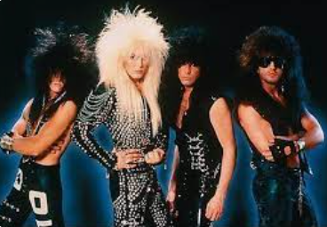
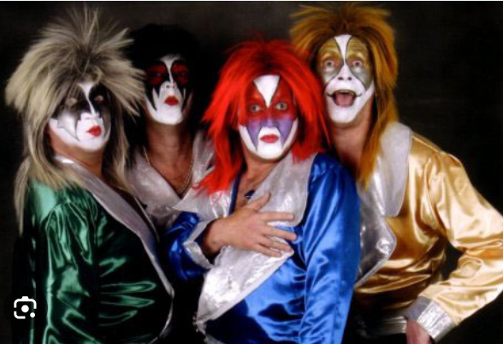
Glam Rock
Space Odyssey
Matching groups
1970’s
Big hair

Slide 7
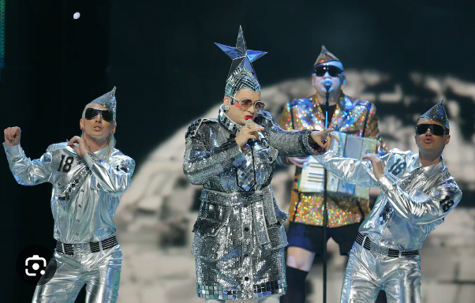

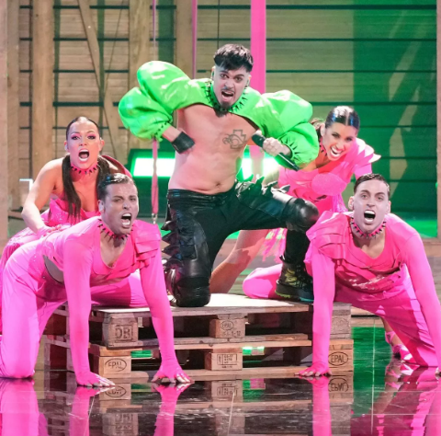
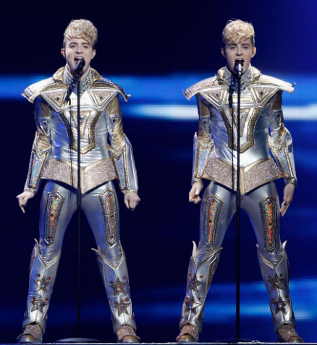

Eurovision
Conchita Wurst
JeDward

Slide 8

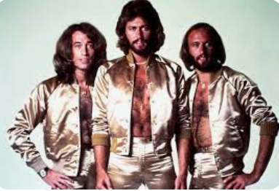
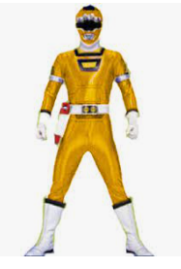
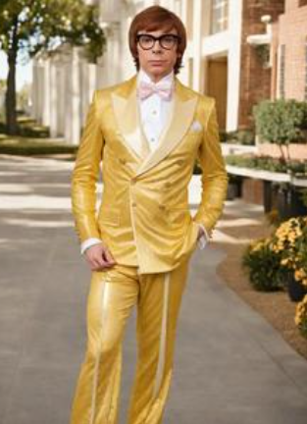
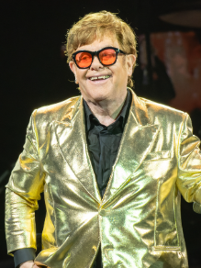
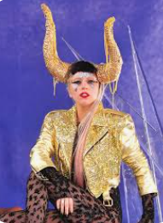
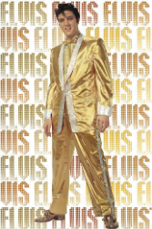

Power Suits
Office Manager
Coffee Break!
Power Ranger
Austin Powers
Senior Academic
Lady Gaga

Slide 9
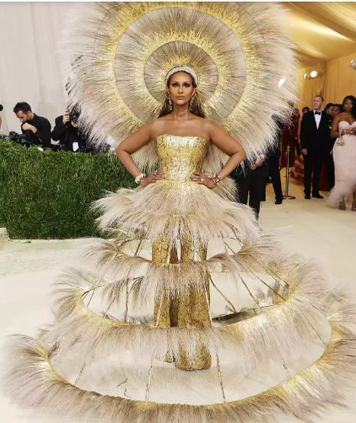
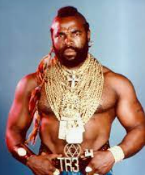

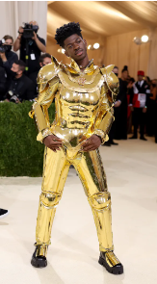
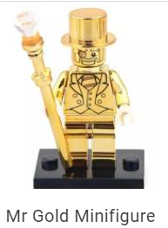

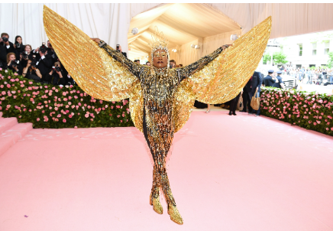
Memorable
Networking idea

Slide 10
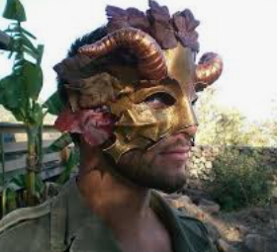


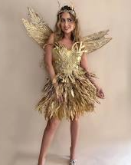

Fairy tale
Fairies, Gold, Egg and Bears

Slide 11
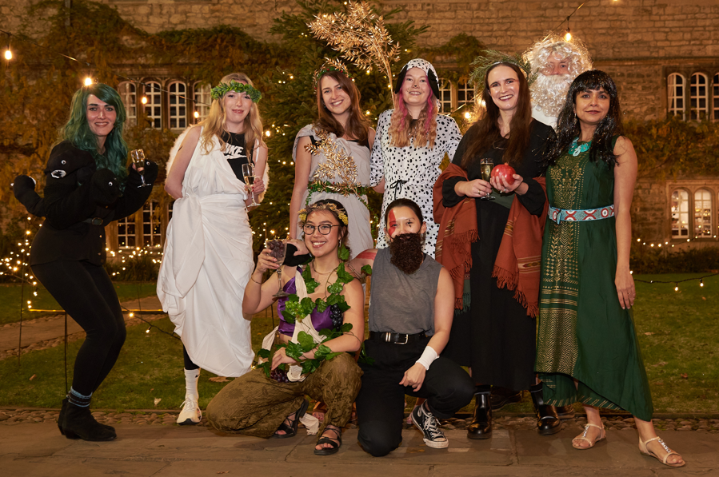
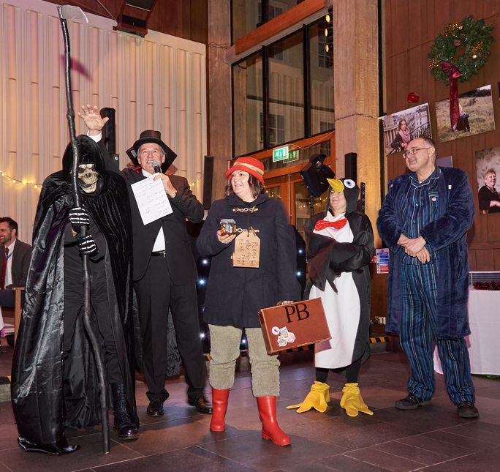
Previous year

Slide 12
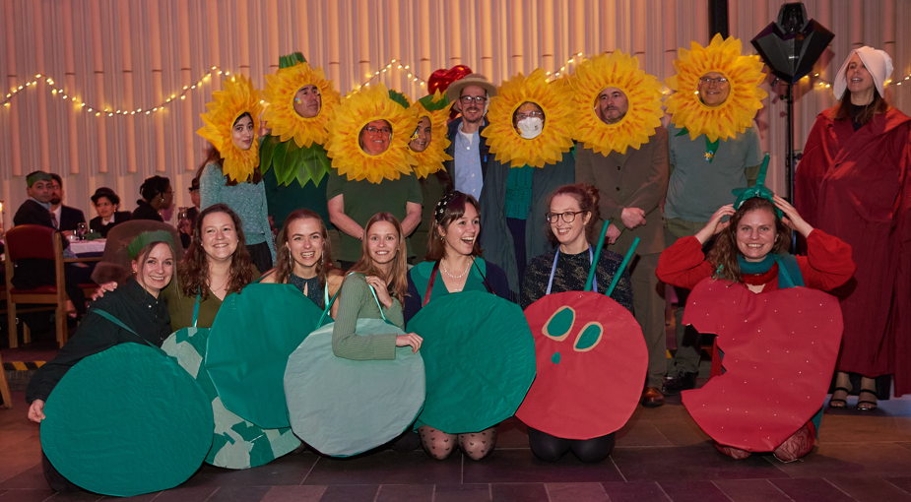
Art & Literature 2022

Slide 13
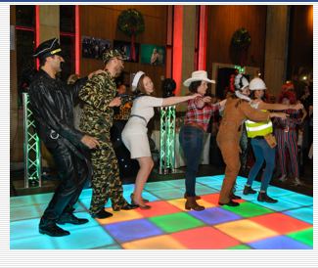
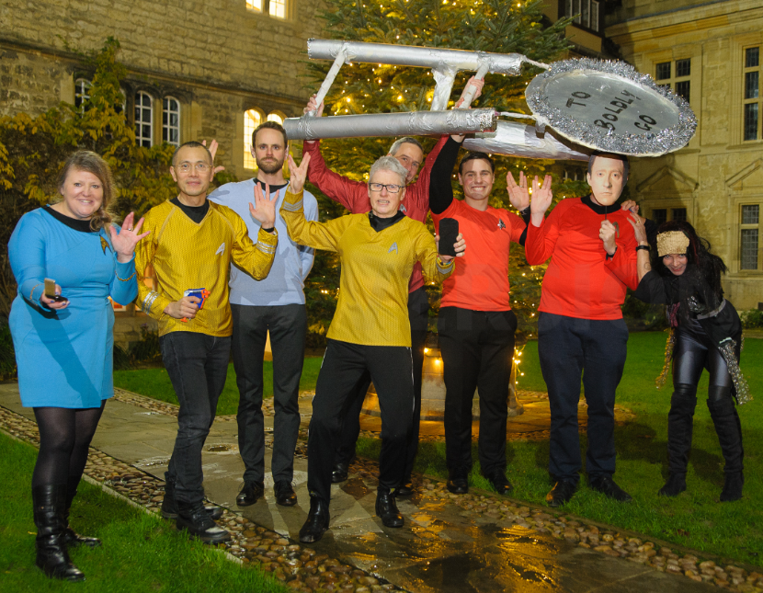
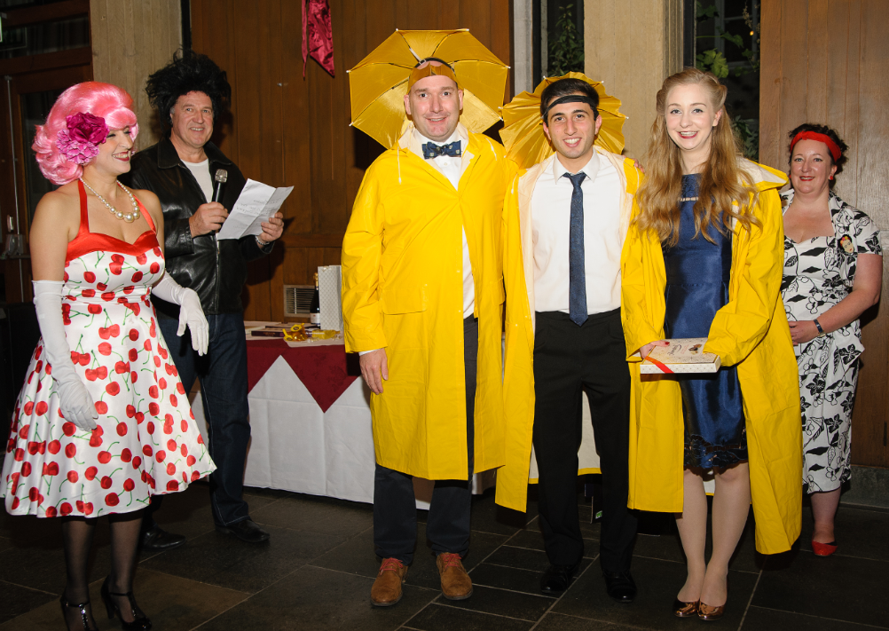
We really go for it…
70s disco theme
Sci-fi & Cosplay
At the Cinema

Slide 14
When: Friday 8th December 2023
Time: 7:00 pm until midnight
Venue: Teddy Hall
(St Edmunds Hall)
Queens Lane, Oxford

Slide 15
Limited places available
There will be a waiting list too
Booking will open Next week.

