Slide 1
Undergraduate Teaching
Department Open Meeting, September 2020
Julian Hancock
Academic Lead for UG Primary Care Teaching
Who we are
What we do
Challenges ahead

Slide 2
Where were we?
RPC & Gibson, Jericho
~300 staff
Old Road Campus, Headington
8
UG Teaching Team (3 admin + 5 clinical teachers)

Slide 3
Where we are now
RPC & Gibson, Jericho
Eagle House, Jericho
~300 staff
8
UG Teaching + Clinical Informatics

Slide 4
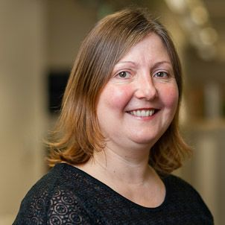
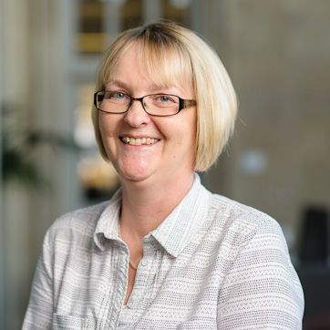
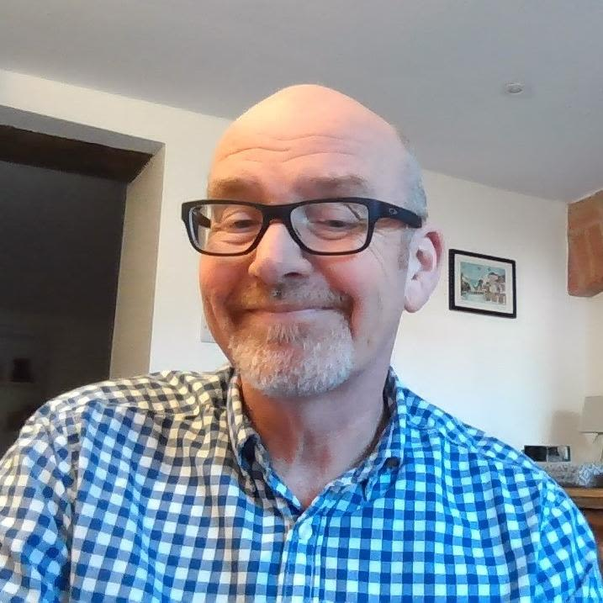
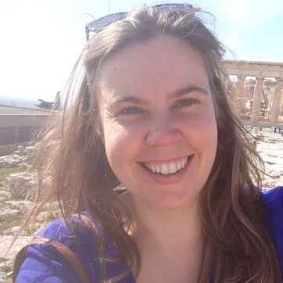
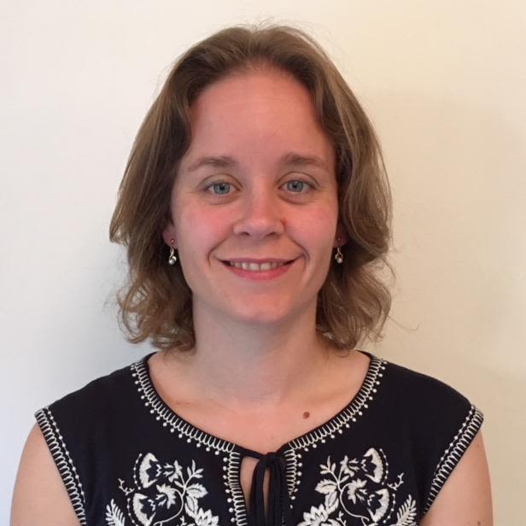
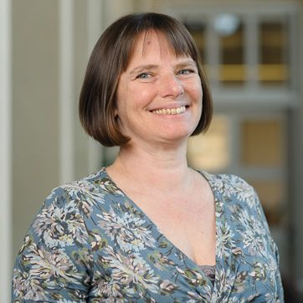
Who we are
Maria
Ruth
JH, Alison C, Rachel A, Ruth W & Helen S

Slide 5
What UG Teaching does
Years 1& 2 (terms 1-5) Patient Doctor 1 Course | Year 3 FHS (Projects in Department) | Year 4 Patient Doctor 2 Course Communication skills DGH placements SSMs | Year 5 Community Based Medicine 6-week clinical placement | Year 6 Mock Exams SSMs
Second BM
First BM
FHS

Slide 6
BUT...
Only 5 - 6% of Oxford curriculum is GP (15% nationally – aspiration 25%)
Low % Ox grads -> GPs (despite having largest academic dept in UK)
Students experience negative attitudes from non-GP teachers
Covid (of course)

Slide 7
RECENT DEVELOPMENTS
Expanding footprint in UG course (PD1, PD2, Year 5)
Modernised curriculum (SAPC/RCGP 2018)
New Annual Student Prize
New courses (SSMs in Year 4 + 6)
Modernised web presence

Slide 8
Challenges
Promote our Dept to students (many want academic careers)
Covid, of course:
Teaching during pandemic
Online modules + virtual seminars on Teams
GP practice reluctance to take back student
What are we preparing students for?
Video consulting for ever?

