Slide 1
Open Access & Act on Acceptance
Juliet Ralph
Bodleian Libraries
2018
Notes:
Open Access refresher for dept of Primary Care. Feb 2018, updated repeat July 2018.

Slide 2
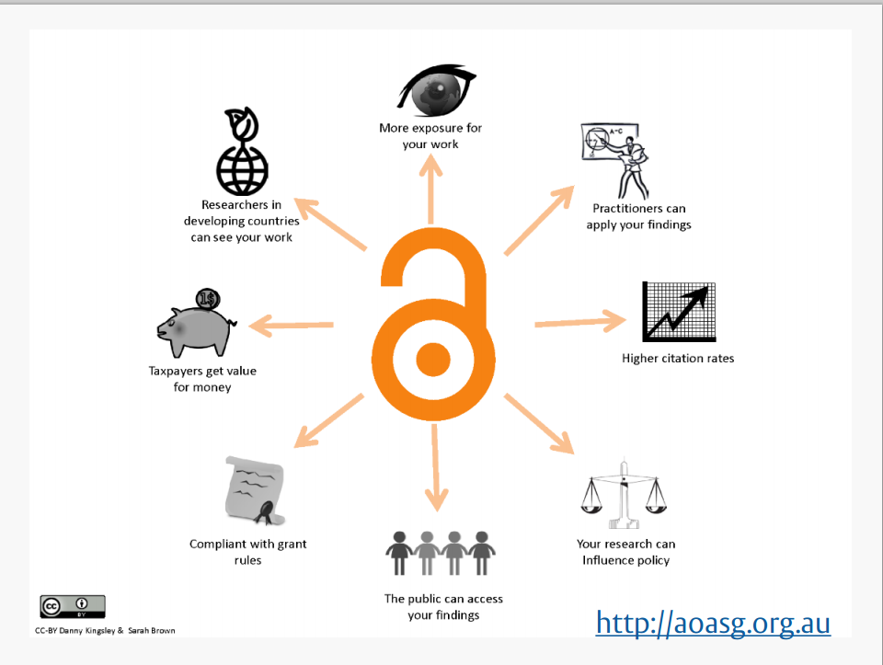
Notes:
Why open access, why deposit. If research is open access, then a greater number of people can access it, benefits both author and reader.
-greater exposure for your work
Higher citation rates (Studies have shown an OA citation advantage for both gold and green open access .)
materials available to researchers in developing countries
Practitioners, professionals, policymakers, students & teachers etc. can access the work. Inc those in UK who aren’t lucky enough to benefit from the institutional subscription access provided by universities for their staff and students. Oxford doesn’t subscribe to every single journal. If an oxford researcher publishes an article in a journal we don’t subscribe to (as has happened), we can at least read the manuscript if they’ve deposited it in ORA.
Part of Public Engagement with Research – enabling people to read in full research findings.
Increased OA is the trend in UK and globally. ‘Monitoring the transition to open access’ – Universities UK report Dec 2017, http://www.universitiesuk.ac.uk/policy-and-analysis/reports/Pages/monitoring-transition-open-access-2017.aspx. “The proportion of UK research which is available via open access is increasing at a considerable rate, with 37% of research outputs freely available to the world immediately at publication. More than half of UK-authored articles are made accessible for public view within 12 months, either through Gold or Green OA.”
Chaired by Prof Adam Tickell , who says in Foreword: “it is vitally important that all research …is of the highest standard, is open to wide critique, and is accessible to everyone, from anywhere with an internet connection, for free. It is also what we should expect from public investment in research. “

Slide 3
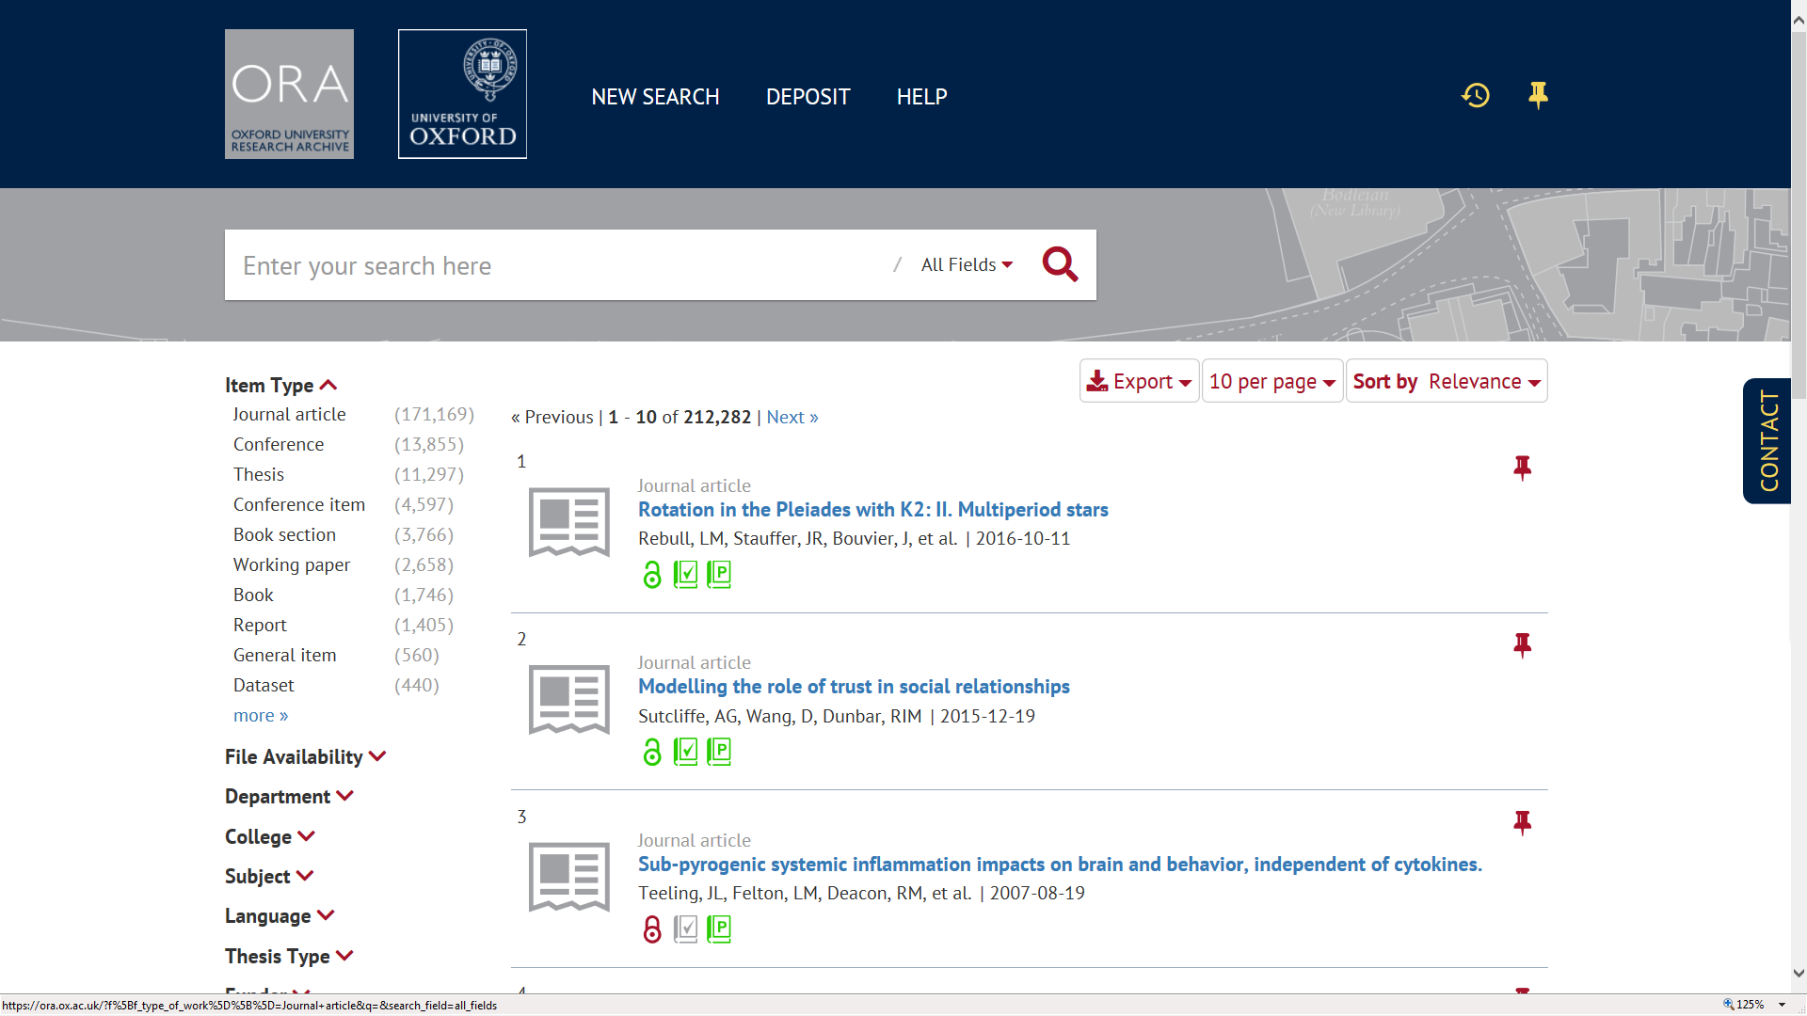
https://ora.ox.ac.uk
Notes:
Researcher deposits in Symplectic (internal admin system) and it feeds through to ORA, our institutional repository for the research output of the University of Oxford.
Nothing goes live until ORA staff check the record and file deposited, they then add information as necessary and then make the record publicly available in ORA.
You get an ORA record with a persistent URL, links to final published version etc. If/when the full-text is available for release in ORA it is also there as a downloadable file.
ORA team behind the scenes checking copyright and dealing with embargo release, and enhancing records and adding links.
Benefits of ORA: visibility/discoverability, preservation/archiving. Peers, students and public can freely read the open access versions in ORA without barriers of payment or passwords. Each item is archived securely for future generations. Full text can be embargoed if required, with the freely available bibliographic record continuing to offer wide dissemination. Records clearly indicate the item type (eg journal article) and whether the work has been peer-reviewed. Repository records indexed by Google etc so Oxford research outputs visible to all. New interface March 2018. https://ora.ox.ac.uk/
The deposit route for Articles and other publications is via Symplectic. (but the deposit route for Theses and datasets is direct into ORA.)

Slide 4


Open Access & next REF
REF2021 policy
What? Journal articles & conference papers (with ISSN) accepted since 1 April 2016
Where? deposit the ‘Author Accepted Manuscript' (AAM) into ORA via Symplectic
When? within 3 months of acceptance date
Notes:
Act on Acceptance is Oxford’s message to researchers.
Why the manuscript and not the published version? because standard publishing agreement allows deposit of AAM but not published version (ie rights retained by author).
Deposit within 3 months of acceptance (ie before you forget / lose the manuscript).
Policy aim is more research available.

Slide 5
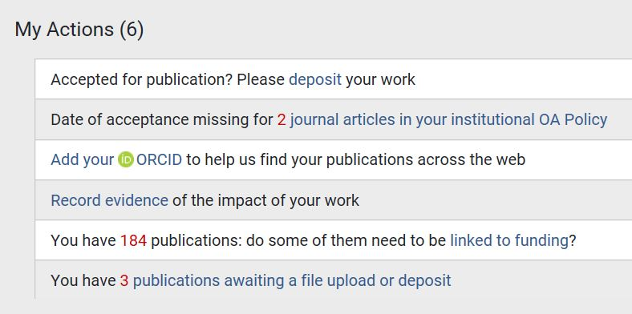
What do I need to get started
1.Symplectic account
2.AAM and Date of Acceptance
Notes:
Academics/researchers get an account automatically (SSO), others can request one eg admin staff/PA in order to deposit on behalf of professor (prof gives them ‘delegate’ permissions so PA can ‘impersonate’ ).
Login to Symplectic and choose ‘Accepted for publication? deposit your work’ .

Slide 6
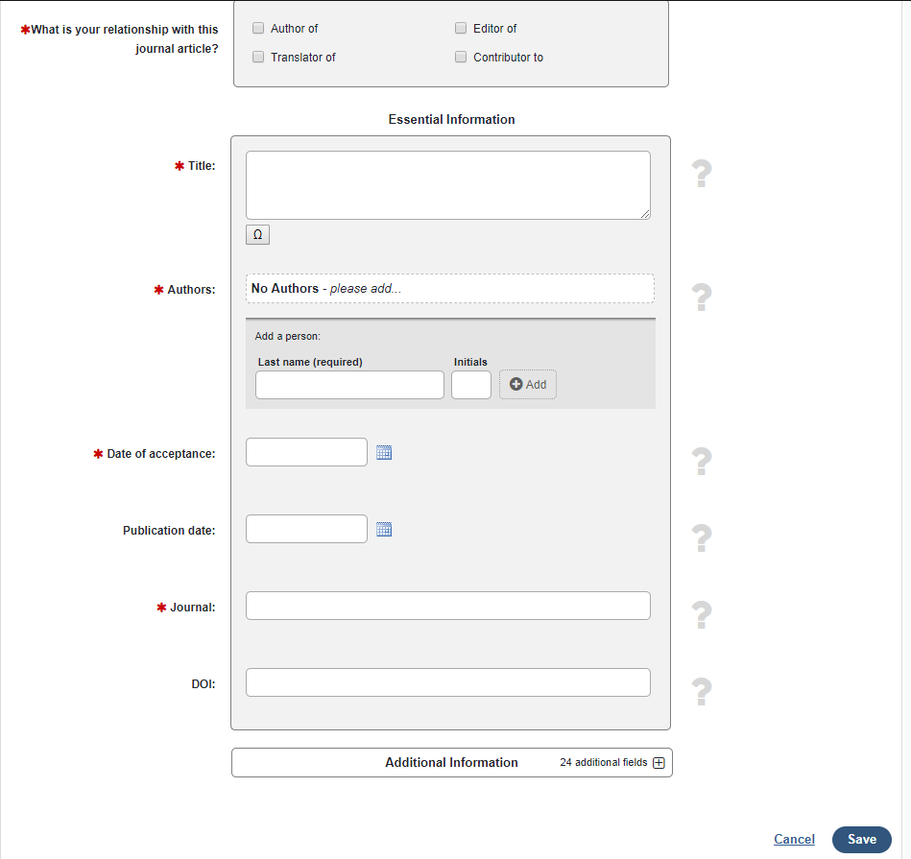
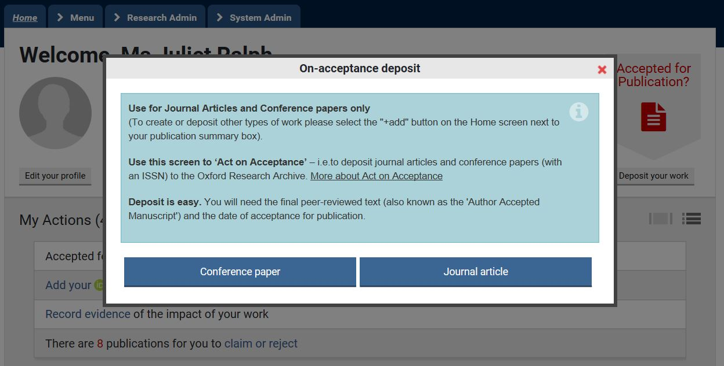
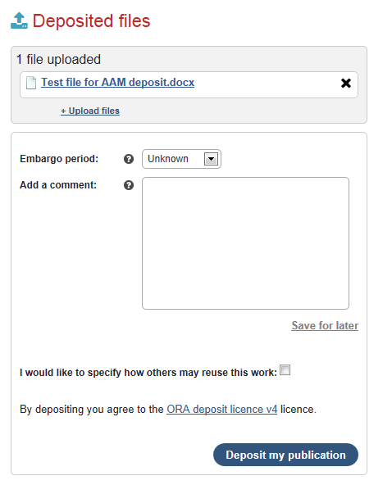

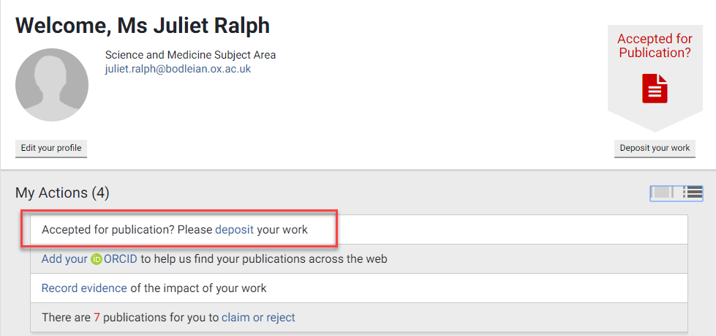
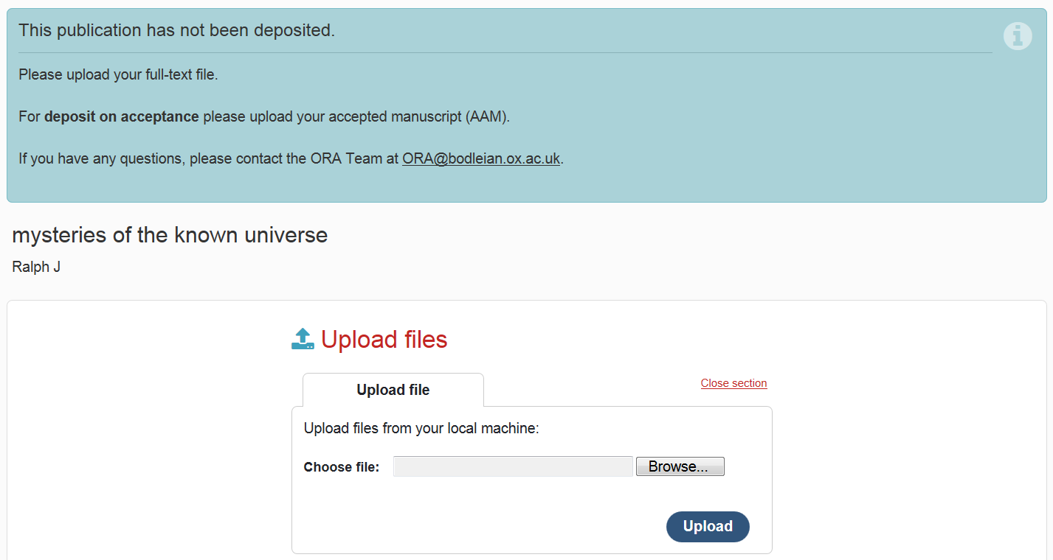
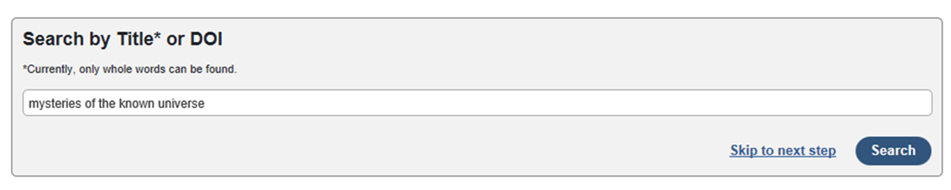

Notes:
Screen shots How to deposit:
Login to Symplectic using SSO (Single Sign On) and choose ‘Accepted for publication? deposit your work’ .
Complete the required fields (author, title, journal, date of acceptance) . Add any other Oxford authors so they get a prompt in their Symplectic account to claim the record (no need for them to also deposit file). Date of acceptance = when finally accepted after peer review completed (not ‘initial’ or provisional acceptance).
Upload Author Accepted Manuscript (final peer reviewed version after all changes made and ready to go).
Upload any supporting files (e.g. images).
MUST click DEPOSIT MY PUBLICATION to complete the process.
Then wait for confirmation email from the ORA team after they have checked and processed the deposit.
If need help getting started , step by step deposit guide on Open Access Oxford website – see Act on Acceptance page at http://openaccess.ox.ac.uk/home-2/act-on-acceptance/.

Slide 7

Oxford’s Open Access Service
You deposit, we’ll take care of the rest
Bodleian team check copyright & licensing, create ORA record and release full-text after embargo
Help with other funder policies
Payment service for Open Access costs (RCUK & Wellcome/COAF).
Notes:
ORA team process deposits.
Subject librarians and OA enquiry line offer help, advice & info, also training - a help contact for every dept. Publicity and training materials – OAOxford leaflet, ‘Act on Acceptance’ and ORCID posters/postcard.
APC team handles Article Processing Charges (APCs), for ‘gold’ open access payment from our Block Grants for RCUK + WT/Charity Open Access Fund if needed to comply with funder policy.
Everyone needs to deposit for Act on Acceptance, whether funded or unfunded.
If also funded by external grant need to be aware of their policy (ideally at stage of grant application – many funders say include costs of dissemination/publication in grant application, eg EU, NIHR). Make sure to meet funder requirements as well as REF. Info on Oxford’s top funders available on OAO website.

Slide 8



at Oxford
ORCID – the unique ID for researchers worldwide
Distinguishes you from others with same name
Helps you link and display your publications
Stays with you wherever you go
Increasingly used by publishers, funders & websites
NEW Link it to Symplectic for Automatic Claiming
NEW ORCID at Oxford service – for ORCIDs with verified Oxford affiliation
http://ox.libguides.com/orcid
Notes:
Increasingly adopted globally, unique ID to solve problem of name ambiguity and correctly link authors with their outputs. Part of researcher toolkit.
Researchers asked to get an ORCID as part of new University OA policy (March 2018).
New benefit - can link ORCID to Symplectic account (in search settings), to help harvesting of records and ‘auto claiming’ . Result of Symplectic upgrade July 2018 .
If sign up through ORCID at Oxford (ITServices page SSO ) your ORCID record will verify oxford affiliation. Anyone can sign up direct on the ORCID site but no verification.

Slide 9
Where to get help
OAO website: | http://openaccess.ox.ac.uk
OA Team: | openaccess@bodleian.ox.ac.uk
Symplectic Elements: | symplectic@admin.ox.ac.uk
ORA: | ora@bodleian.ox.ac.uk
APC Team | apc@bodleian.ox.ac.uk
REF FAQ | http://openaccess.ox.ac.uk/faq-next-ref
Notes:
Starting point for information on open access at Oxford (and how to make sure that your work is eligible for the next REF ) is the OAOxford website.
Local contacts list at http://openaccess.ox.ac.uk/contact-us/ for departmental OA Admin and Academic leads , also subject librarians.
Health Care Libraries Outreach librarians (up the hill )- http://www.bodleian.ox.ac.uk/medicine/using-the-libraries/outreach_librarians
Bodleian Subject librarians (down the hill, Radcliffe Science Library) - www.bodleian.ox.ac.uk/subjects-and-libraries/subjects/librarians

