Slide 1
Adding new members of staff:
To the Weekly update and welcome email lists
To the department ‘all staff email’ list
To the department website(s) as a profile

Slide 2
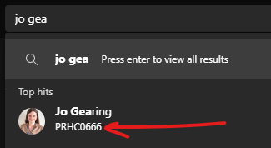
Firstly…
It may be quickest to gather all the info you need first, this file tells you all of the info you need to collect.
Tip
Finding an SSO – click the search bar in Teams and start searching for the name of the person. Their SSO will appear in the search tips.

Slide 3
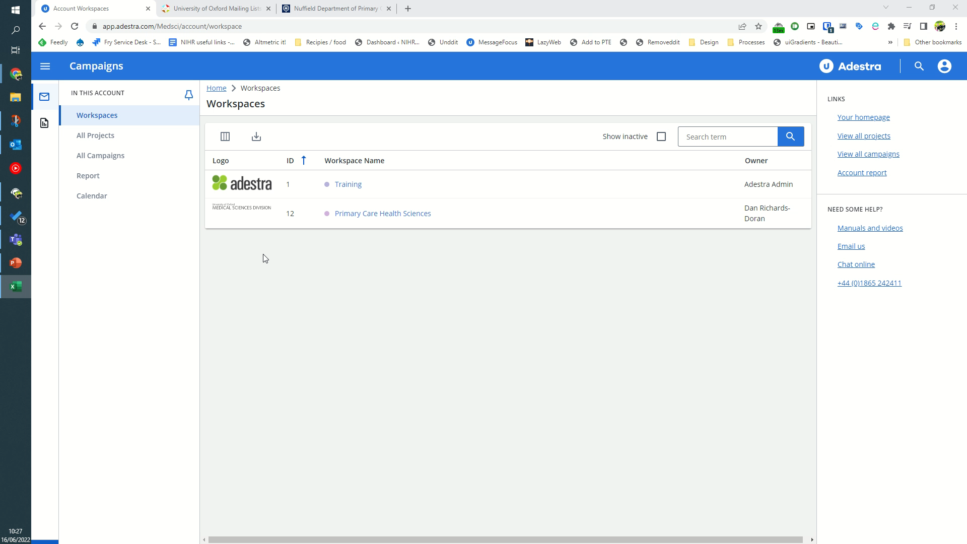
Adding people to the Weekly update list, and Department Welcome email list
Sign in to Adestra
Click ‘Primary Care health Sciences’
Select the databases icon
Select the main mailing list database “Primary Care members List”
Click “Add new contact”
Complete details and click ‘Save’.
Repeat steps 3-6 but selecting the “PHC welcome email” database.
(Note: this will immediately send the welcome email as soon as a new person is added.)

Slide 4
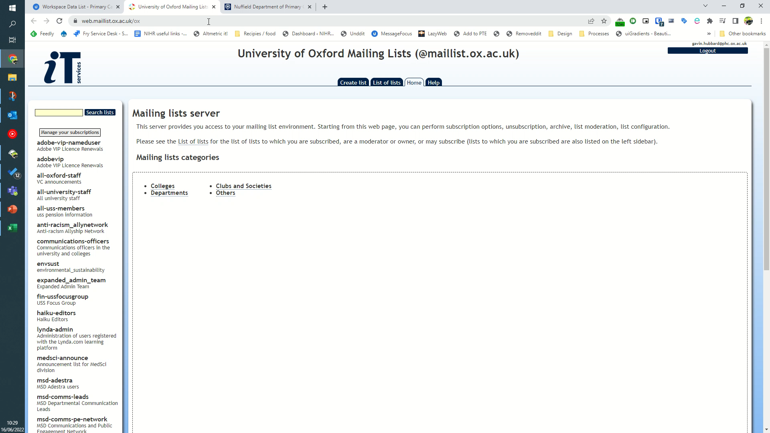
Adding people to department mailing list
Sign in to “
Sign in to https://web.maillist.ox.ac.uk/ox”
If necessary, scroll down to select primary care and select it.
Click on ‘Admin’ under subscriber options
Select the ‘manage subscribers tab’
Add the new email address in the ‘Add a user:’ box.
Select the ‘quiet’ tick box – this prevents them being emailed to say they have been subscribed.
Click ‘add’.

Slide 5
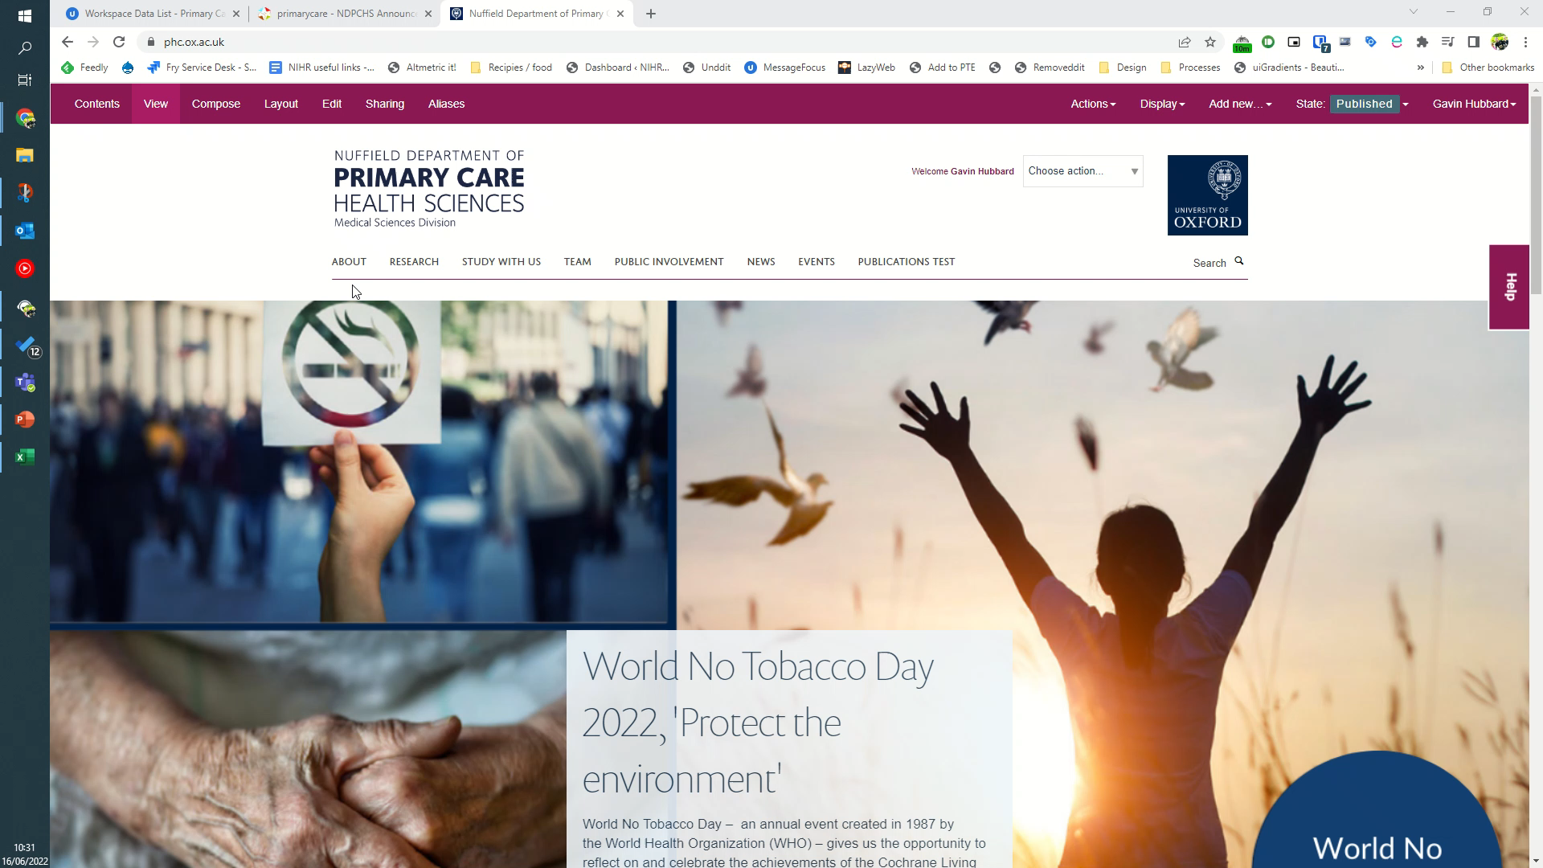
Adding a profile to a Haiku website
Sign in to the website (typically www.phc.ox.ac.uk) as normal.
Select ‘Team’
On the bar at the top, click ‘add new’, then click on ‘profile’.
Complete the details.
Note: the username is the persons SSO user name without the @ox.ac.uk at the end. E.g. prhc12345
Select the categorisation tab.
Scroll to find the appropriate category, then press the right arrow to add it to their profile.
Click Save.

