Slide 1
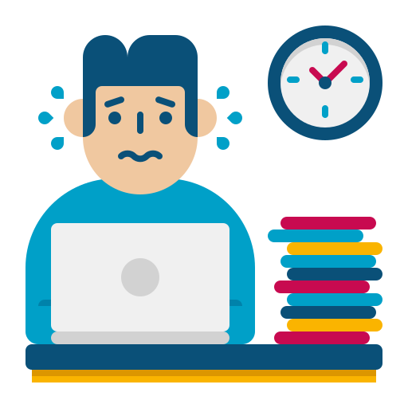


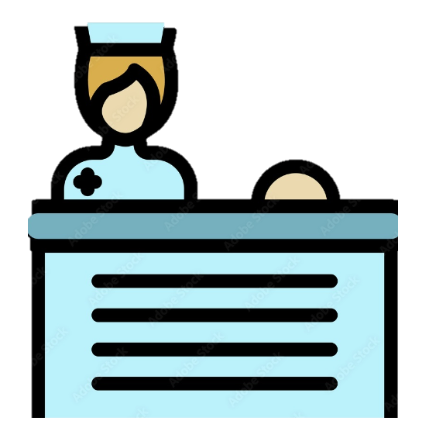
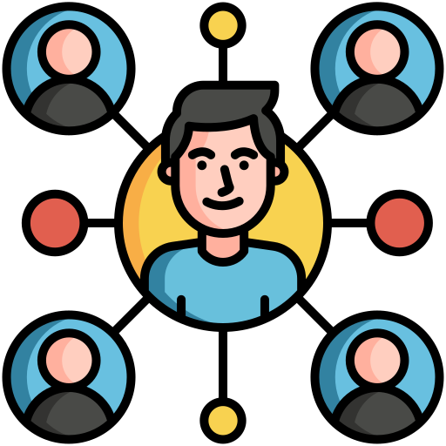
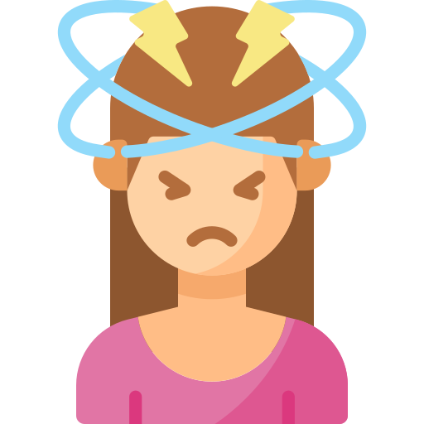
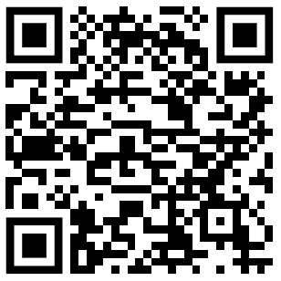
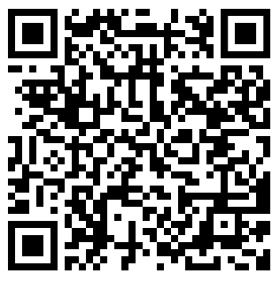
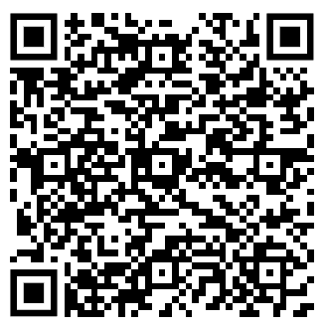
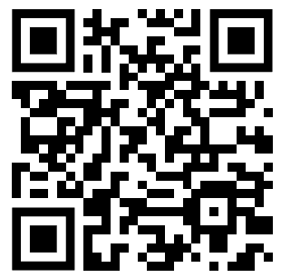
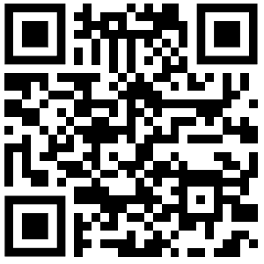
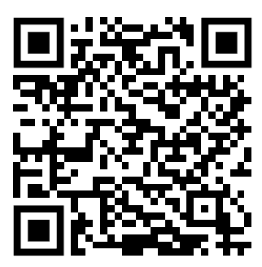
Digital access, triage, and inequalities: navigating digital candidacy
Reflections from the Remote by Default 2 study
The landscape of UK general practice has fundamentally changed. It now involves a web of multiple organisations, people, and technologies. Patients and staff navigate this multi-modal network to access and deliver care. This resource outlines how the assumptions made by technologies can introduce, compound, and reinforce inequities in access to care.
To access care in modern GP, patients must: locate and navigate services, assert and articulate their needs, self-advocate, and negotiate their way through multiple stages in the access pathway.
These pathways and technologies have inbuilt assumptions about the capacities, needs, and skills of ‘intended users’, limiting who can use them effectively. There is a consistent disparity in patients' capability to judge their health needs as worthy of care, access digital healthcare platforms, advocate for themselves, and navigate the healthcare system.
How well patients can use these technologies dictates how accurate the digital facsimile they create is. Patients with low digital literacy, health literacy, and system literacy are less likely to create an accurate digital facsimile, misrepresenting their needs to the practice, or sending them down inappropriate algorithmic pathways or into ‘safety-traps’.
Staff use the information provided digitally by patients to help them determine their eligibility for care, and appropriately triage. An accurate assessment relies on the accuracy of the digital facsimile.
Some staff could share situated knowledge about their patient population and individual patients to fill in the gaps, help patients create more accurate digital facsimiles, and anticipate patients likely to have inaccurate digital facsimiles.
Patients’ experiences at the ‘digital front door’ of general practice influenced their ongoing engagement with the healthcare system. Being deemed ‘not eligible’ for care on one occasion shaped their future self-assessment and help-seeking behaviour.
Learning summary for practice
Digitalised access and triage require patients to successfully interact with technological gatekeepers to build a digital picture of their candidacy for care.
These technologies are encoded with inbuilt assumptions about users, which limits how they can be used, and by whom.
For some patients, the technologies are intuitive and can speed up triage of simpler cases for staff.
However, the technologies’ assumptions push back other users, with downstream effects on patients' willingness to engage with health services.
Making access much easier for some but not all can obscure those who find access more difficult.
Without careful design, digitalised systems may exacerbate existing inequities, and create new ones.
These findings underscore the need for localised approaches to multi-modal service configuration and design.
Learning summary for policy
Avoid top-down mandates for using specific modalities or taking up specific technologies, allow the practice the space to determine what works locally (for staff and patients).
When investing in new technologies, be critical of the research & development behind the product, and whose voices/needs may have been overlooked
Don’t be afraid to allow for de-implementation when a technology/modality has proven inappropriate for local needs (and do not measure success or efficiency based on use of such technologies)
Avoid over-protocolization of access/triage pathways: staff need to be able to work creatively for solutions to inequities and misrepresentations caused by digitalised pathways
These digitalised pathways and systems mean new competencies are required of staff and patients.
Summary of staff digital competencies
Patient guide for telephone appointments
Additional public-facing study outputs
Academic paper: clinical staff training
Academic paper: support staff training
Academic paper: digital candidacy

