Slide 1

Local details here
Local details here
Local details here
Local details
Please enter local details of groups supporting specific conditions.
Local details here
Local details here
Please enter local community groups
Please enter local details here
Local details
Please enter local details of groups that support healthy eating
Please enter local details here

Slide 2
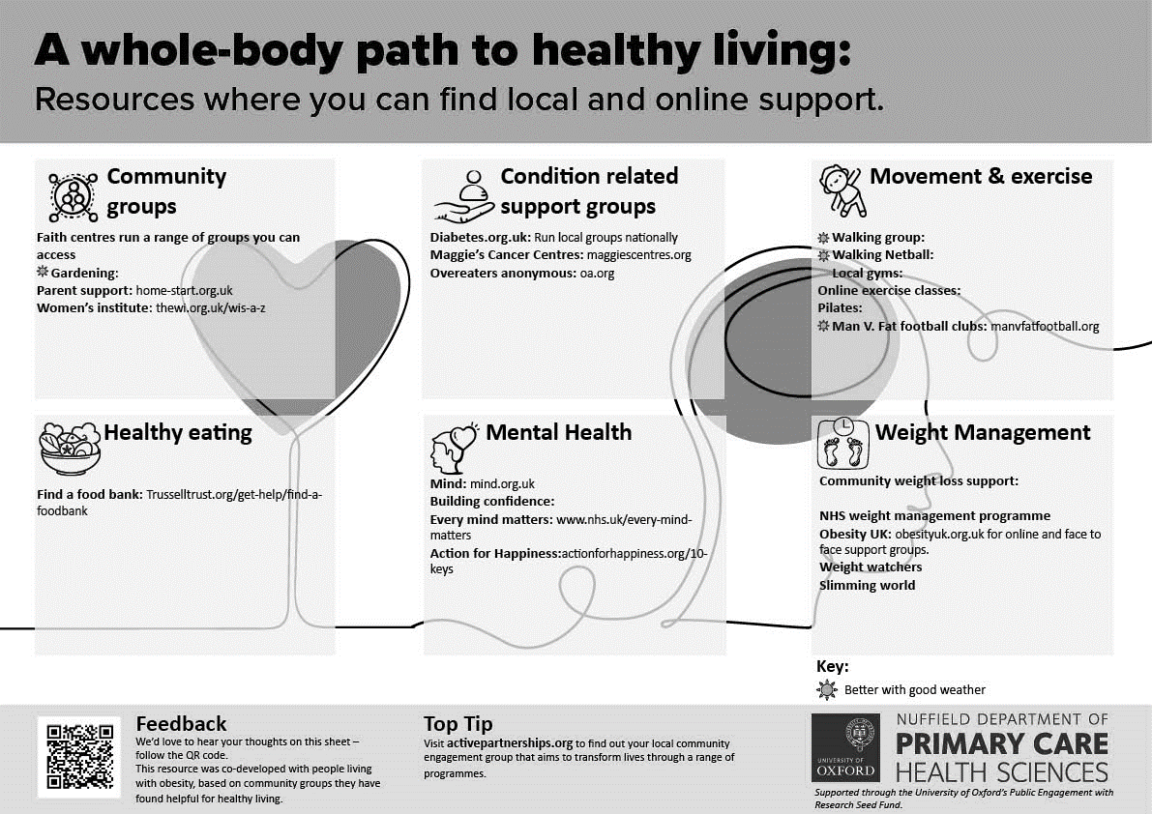
Local details here
Local details here
Local details here
Local details
Please enter local details of groups supporting specific conditions.
Local details here
Local details here
Please enter local community groups
Please enter local details here
Local details
Please enter local details of groups that support healthy eating
Please enter local details here

