Slide 1
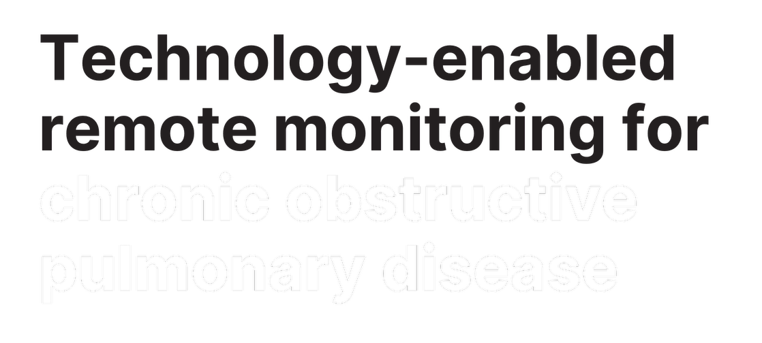


Slide 2


Slide 4

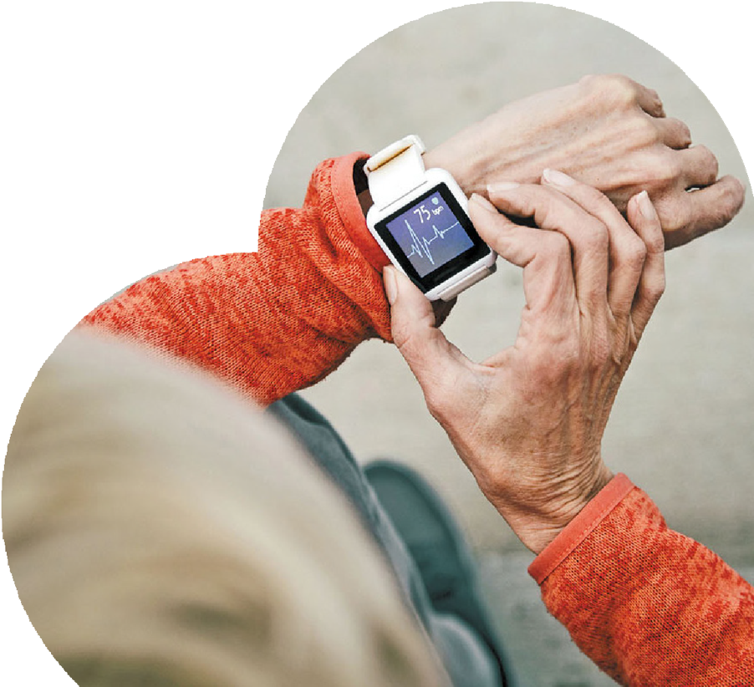
[insert your service name here]

Slide 5


Slide 6
Insert a tick or a cross next to the service/s you offer.
Remember to delete the prompts when you’re done!

Slide 7


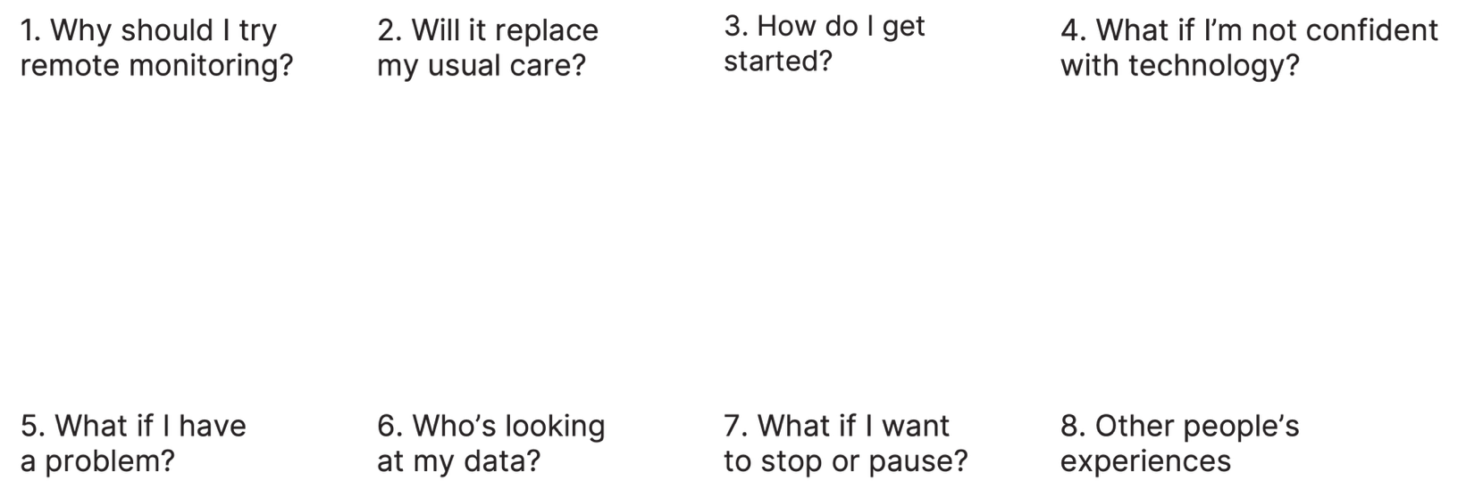

Slide 8
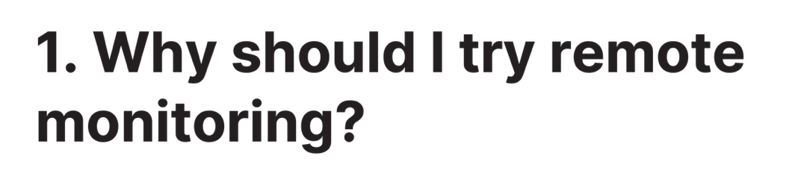
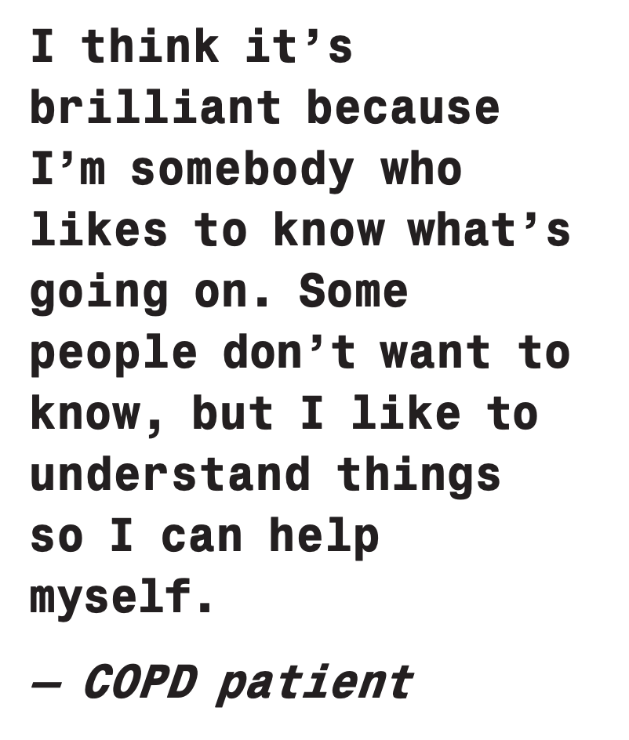
[Edit this text based on your knowledge of your patients and the technology enabled remote monitoring service you are offering them:
What benefits might this service bring to your patients?
Can you explain how the technology supports independence rather than replaces care?
What evidence or feedback (local data, patient quotes) could you use to make the message credible?
Don’t forget to delete this prompt when you’re done!]

Slide 9

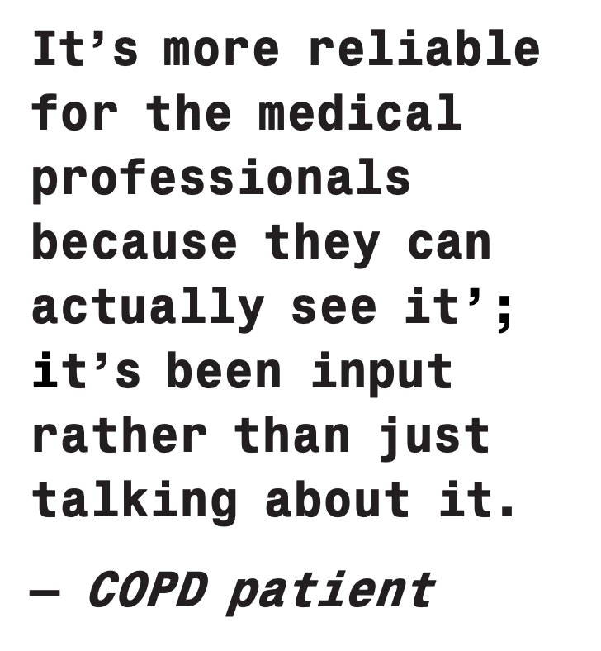

[Edit this text based on your knowledge of your patients and the technology enabled remote monitoring service you are offering them:
How can you describe clearly what stays the same (e.g. GP reviews, in-person visits) and what changes?
When and how will clinicians review TERM data alongside routine care?
How can you reassure patients that TERM adds extra support, not extra burden?
Don’t forget to delete this prompt when you’re done!]

Slide 10

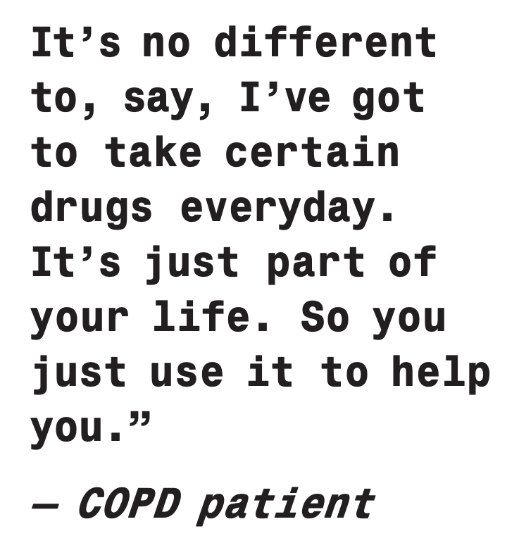

[Edit this text based on your knowledge of your patients and the technology enabled remote monitoring service you are offering them:
What are the exact steps for onboarding (device delivery, login, first reading, contact point)?
Who provides first-use guidance (e.g. nurse call, video, leaflet) and when do they follow up?
What local adjustments are needed and what can/can’t you provide (language support, accessibility, digital-skills help)?
Don’t forget to delete this prompt when you’re done!]

Slide 11
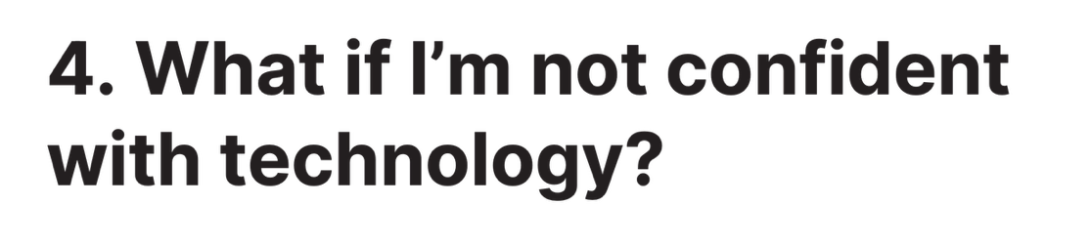
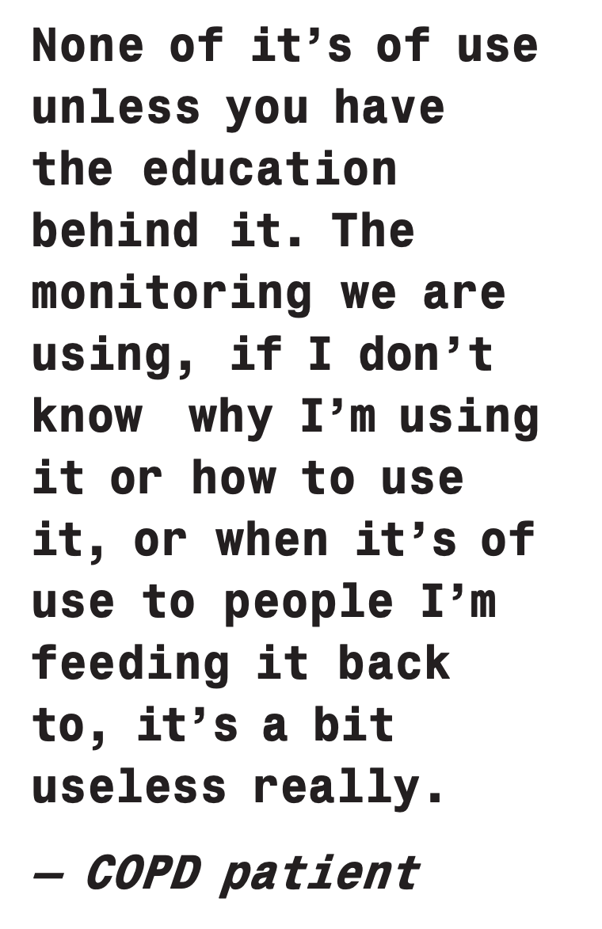

[Edit this text based on your knowledge of your patients and the technology enabled remote monitoring service you are offering them:
What practical help will you offer (set-up, printed steps, helpline, carer support)?
Who checks in early to build confidence, and when (timing/frequency)?
How will you spot and re-engage people who disengage due to digital barriers?
Don’t forget to delete this prompt when you’re done!]

Slide 12

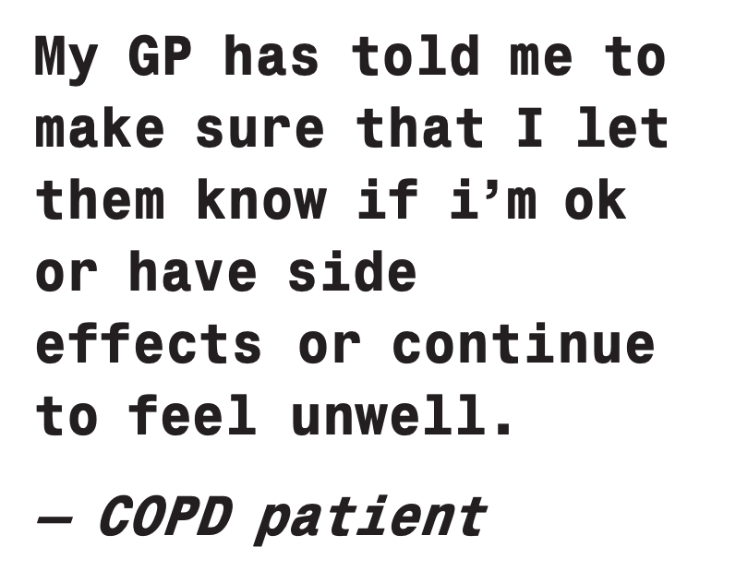
[Edit this text based on your knowledge of your patients and the technology enabled remote monitoring service you are offering them:
How should patients report tech vs clinical issues (numbers, app message, hours)?
Who monitors queries/alerts, on which days/times, and what is the response time?
What are red-flag symptoms that mean “call usual/urgent care” immediately?
Don’t forget to delete this prompt when you’re done!]

Slide 13

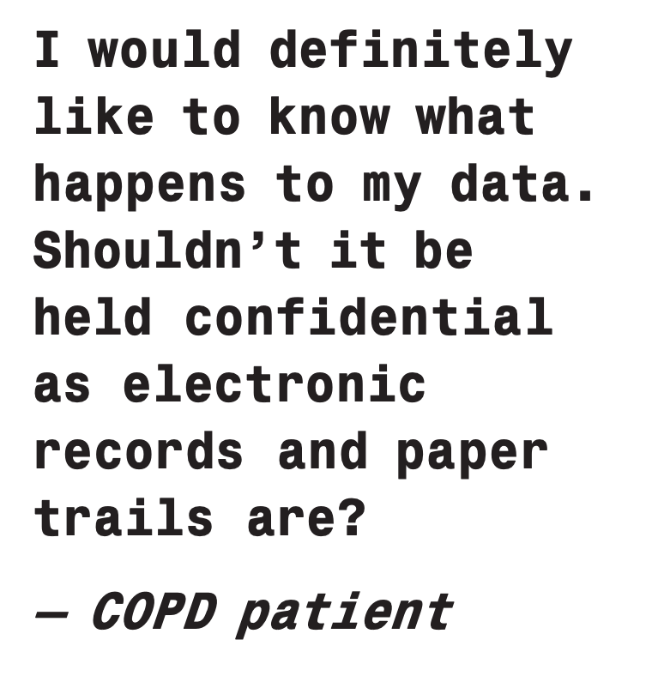
[Edit this text based on your knowledge of your patients and the technology enabled remote monitoring service you are offering them:
Which roles review data (how often) and how are decisions/escalations made?
How do you explain dashboards, data storage, and confidentiality in plain language?
How do you reassure that readings are interpreted by qualified staff, not just an app?
Don’t forget to delete this prompt when you’re done!]

Slide 14

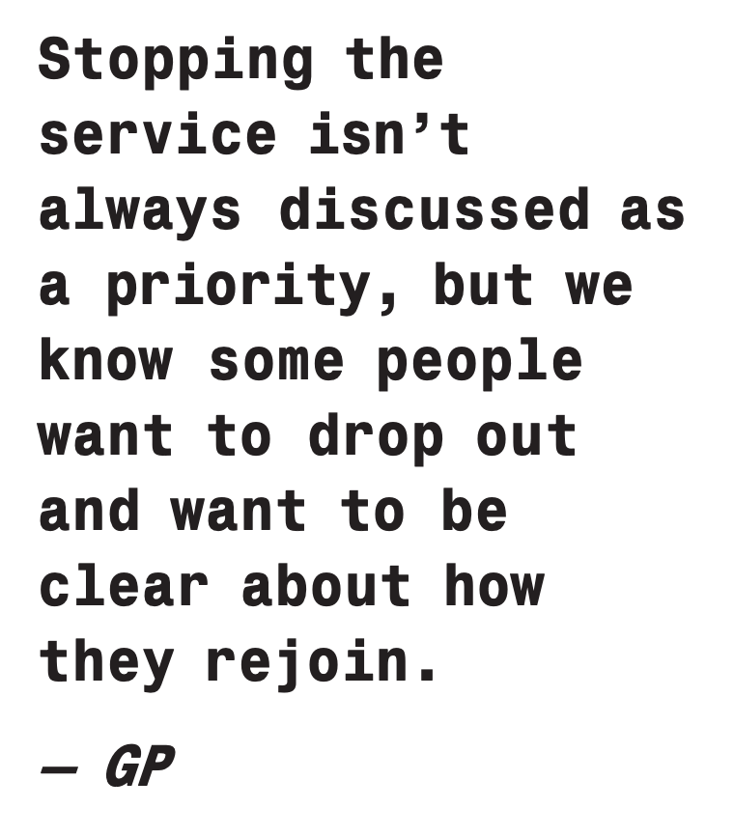
[Edit this text based on your knowledge of your patients and the technology enabled remote monitoring service you are offering them:
What’s the opt-out/pause process and who should patients contact?
How can patients re-join later (re-onboarding steps, expected timelines)?
How do you emphasise that TERM complements - not replaces - routine/emergency care?
Don’t forget to delete this prompt when you’re done!]

Slide 15





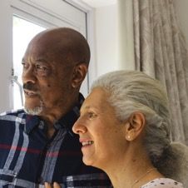


Slide 16

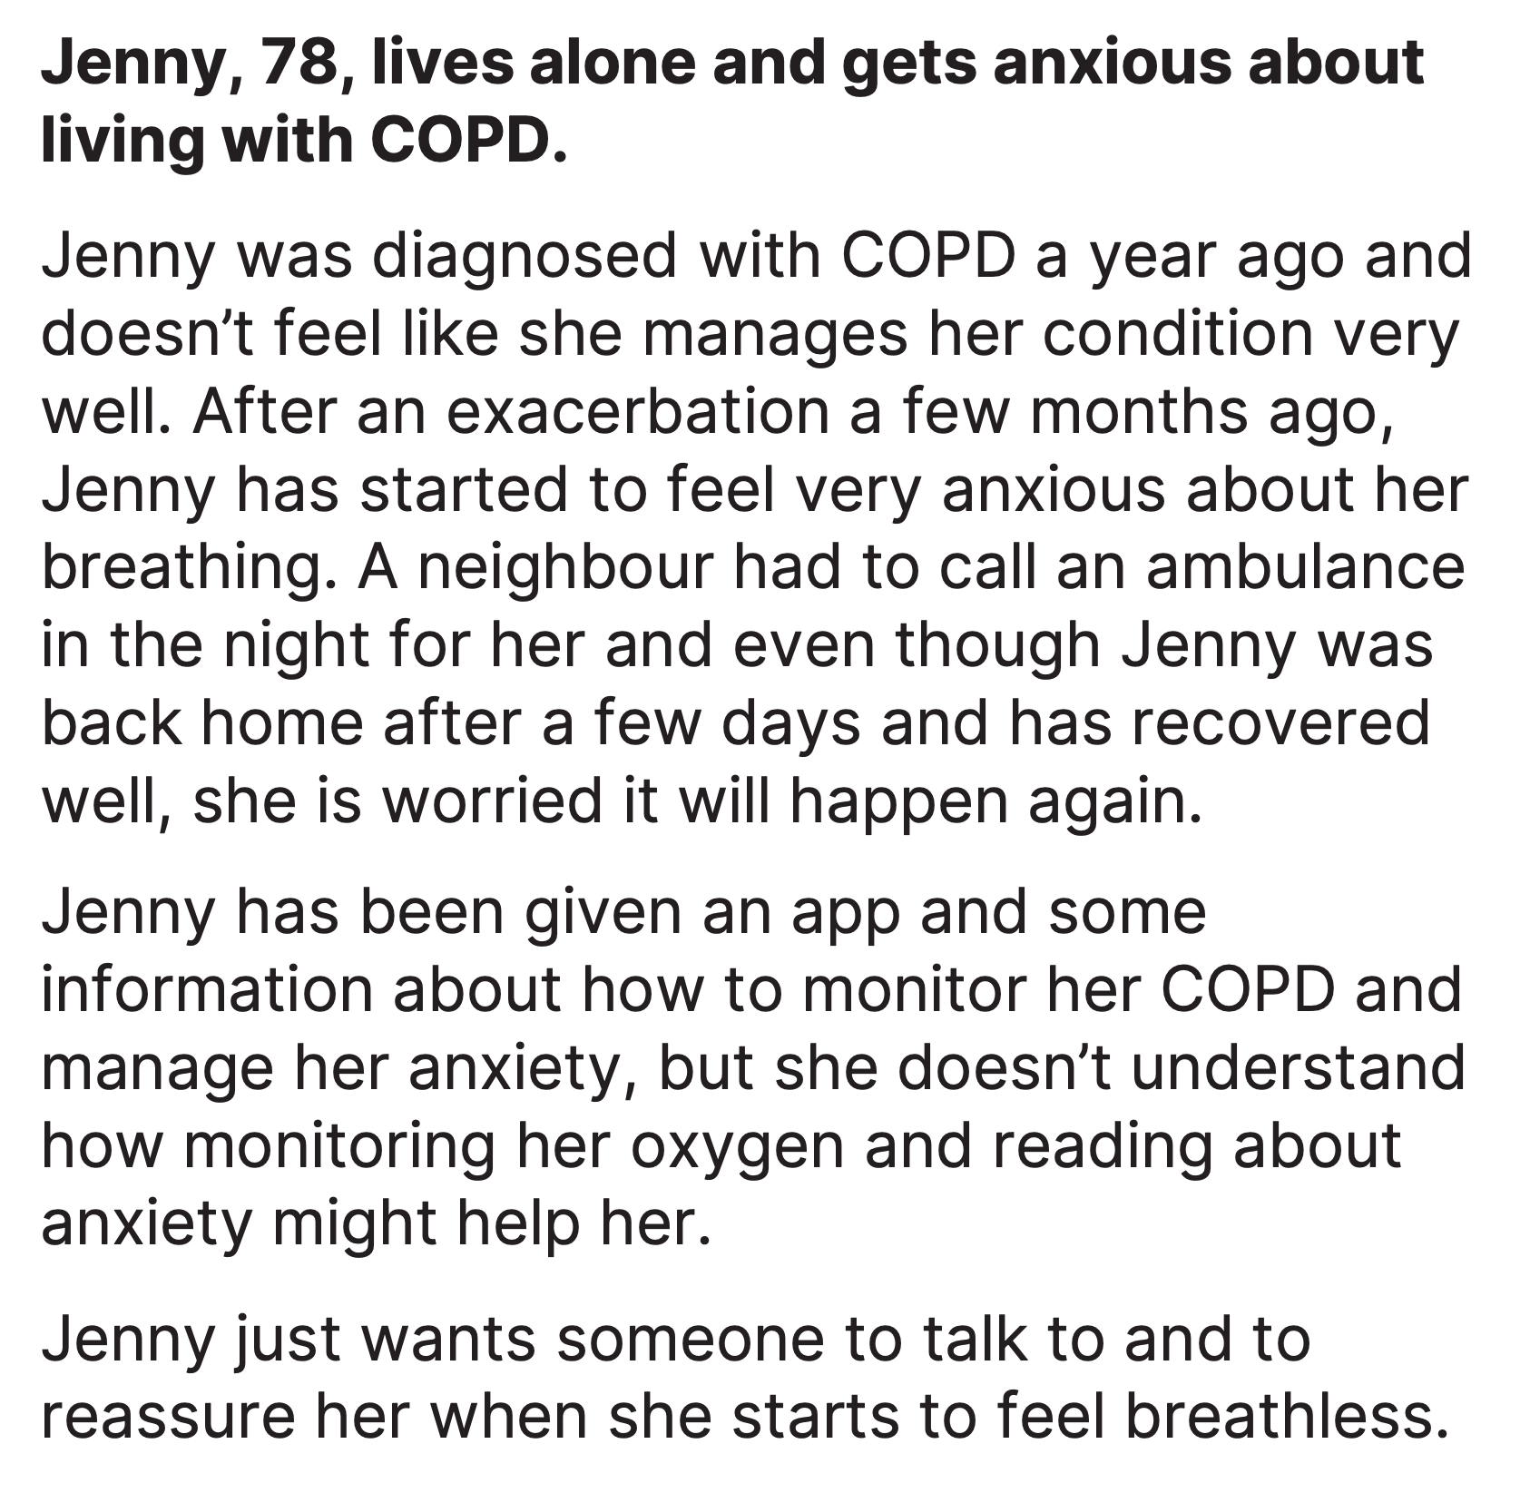



Slide 17

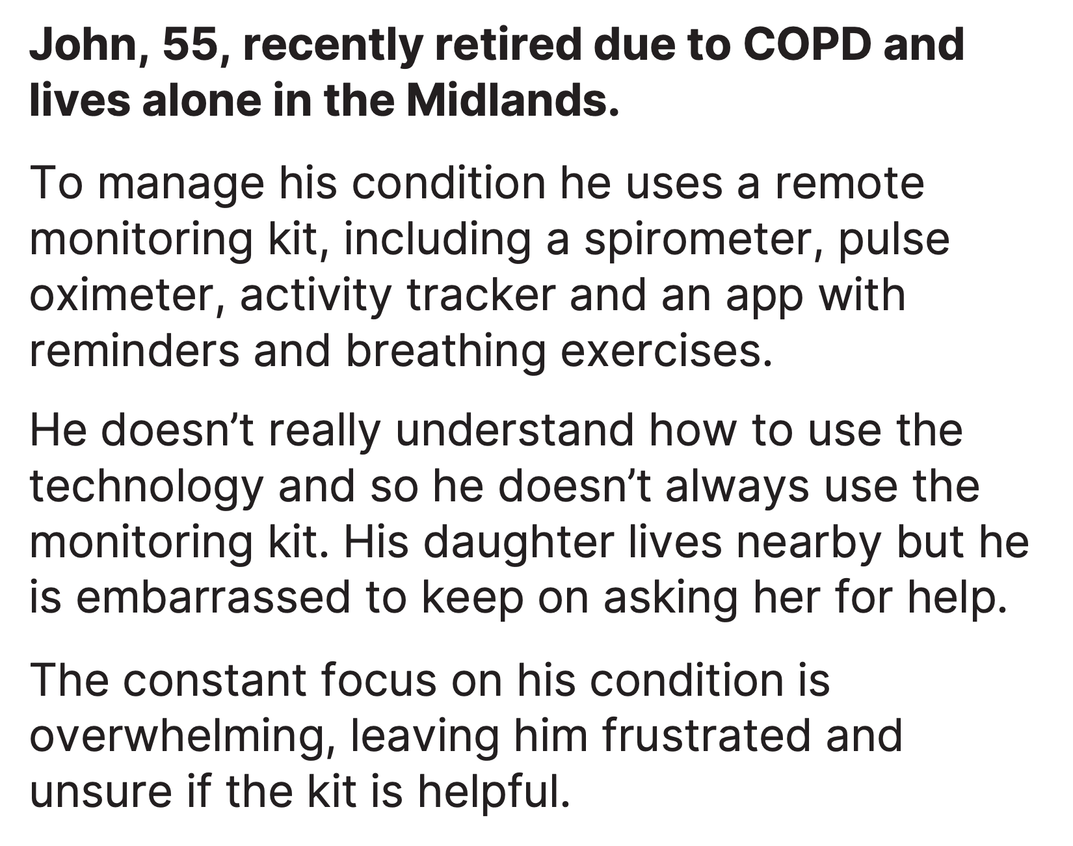



Slide 18

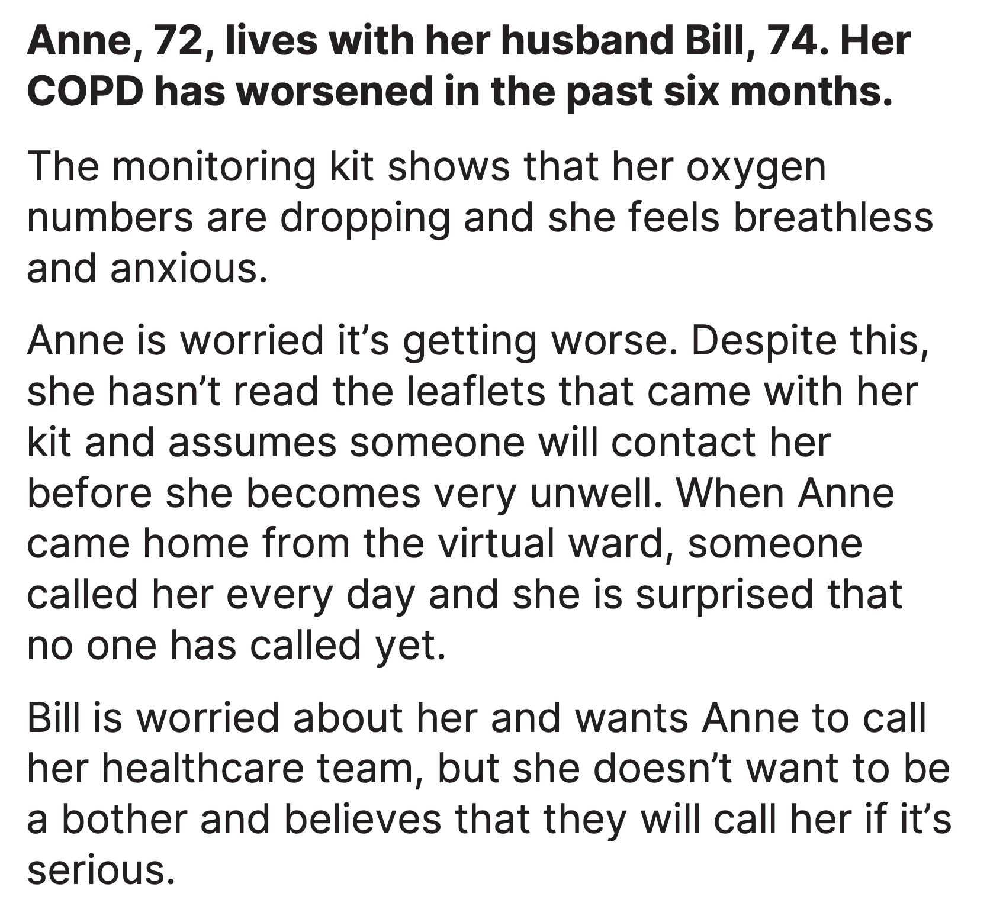
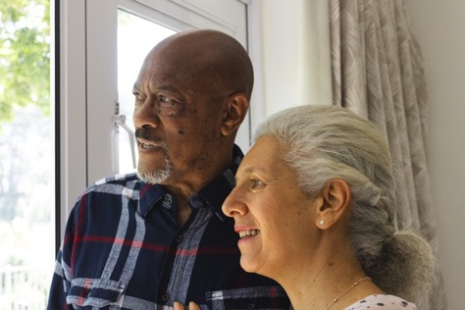


Slide 19

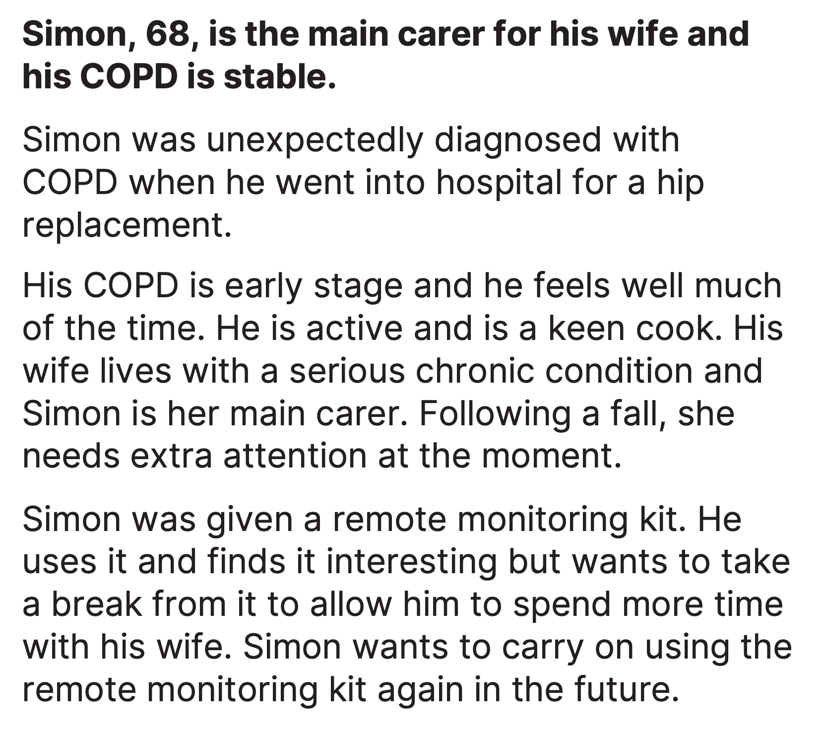



Slide 20

[insert your service name here]
Questions?
[Edit this text based on the support you offer
Add relevant contact details here and clear guidance on when this contact is/is not available
Don’t forget to remove this prompt when you’re done!]
17

