Slide 1
REMEDY project
REmote MEDication made easY
May 2023
Reducing inequalities in access to medicines for those in underserved areas

Slide 2
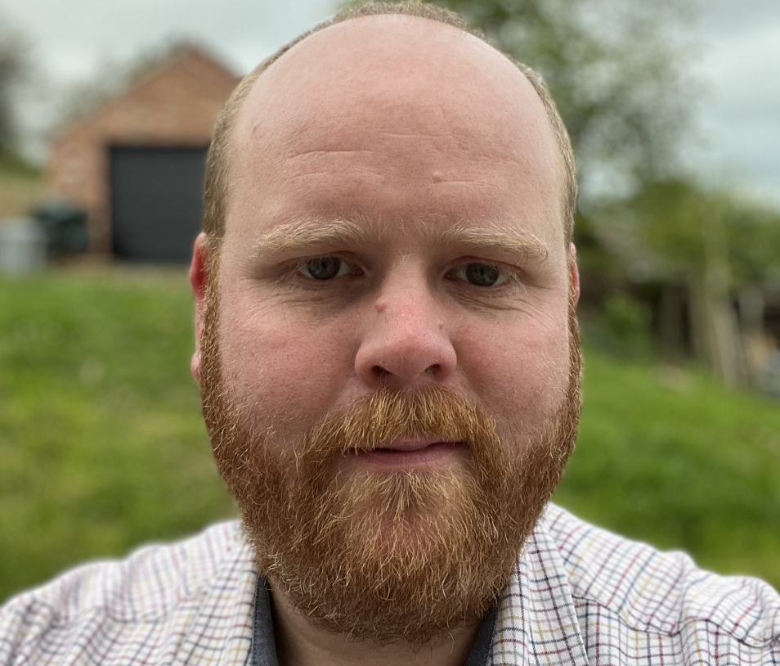
Team REMEDY
Dr Rebecca Payne
NIHR Fellow, OOH GP, former CQC clinical lead Urgent Primary Care
Prof Christine Bond
Professor Emeritus, Aberdeen University, Pharmacist & Health Services Researcher
Prof Aileen Clarke
Professor Emeritus, Warwick University, Policy and Evaluation Researcher
Dr Archie Lodge Dual trained doctor and engineer, Academic F1
Dr Joseph Wherton PI Senior researcher, psychologist specialising in human-computer interactions
Dr Adam Mackridge, Strategic Lead for Community Pharmacy, Betsi Cadwaladr Healthboard & NHS 111 Clinical Lead Pharmacist (North), NHS 111 Wales
Prof Trisha Greenhalgh
Ric Atalla, Operational Manager, Emergency Care and Inpatients, NHS Forth Valley

Slide 3

What is the problem?
Issuing of medication when pharmacies are shut/geographically remote
  E.g. Patients following a telephone call requiring medication
  Patients following face to face appointment

Slide 4
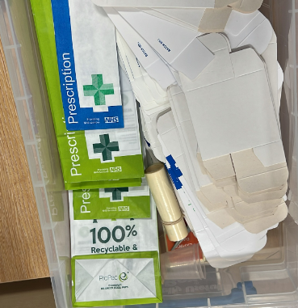
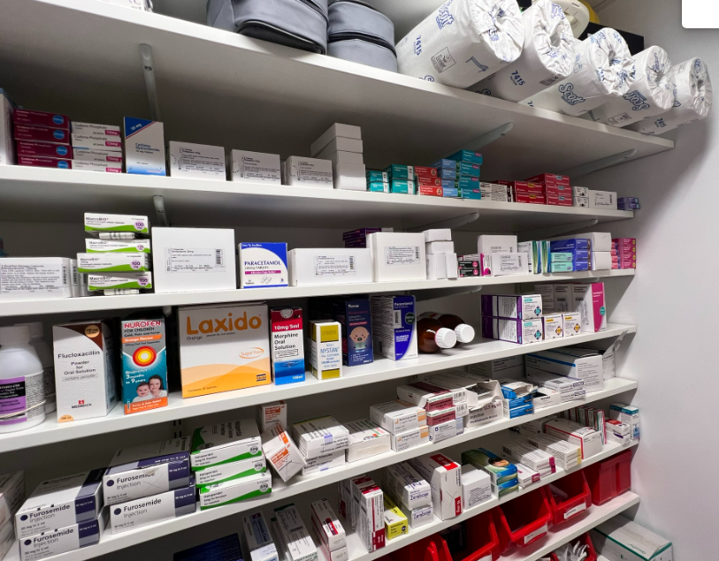
Example of current practice
Clinician dispenses from stock
Patient attends OOH hub to collect
Challenges
  Time taken (40% of clinicians state more than 5 mins)
  Risk of diversion
  Off-site advice calls
  Staff needed to give patient the medication
  Long trips for some patients to collect medication
  Potential delays in starting urgently required medication e.g. antibiotics

Slide 5
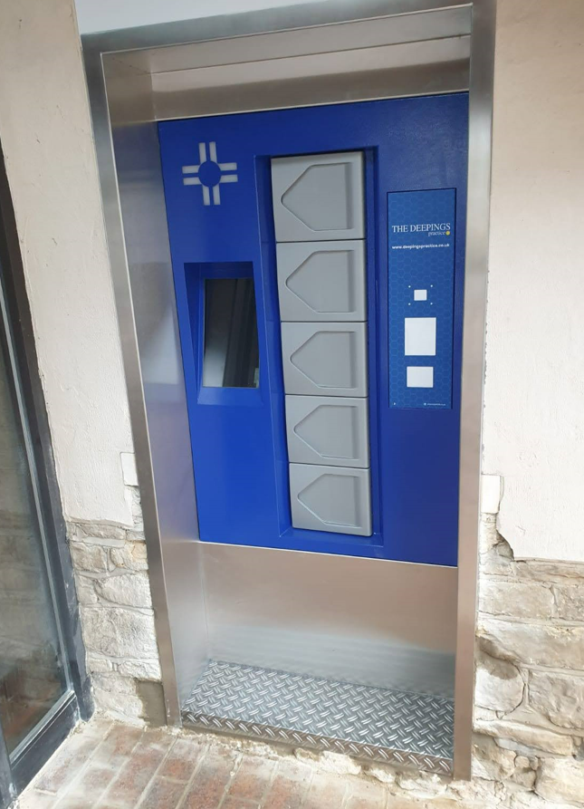

How a medication vending machine might help….
Clinician completes consultation
Clinician logs into machine remotely & selects medication
PIN code given to patient (text/email/verbally)
Patient collects from the machine using unique PIN

Slide 6
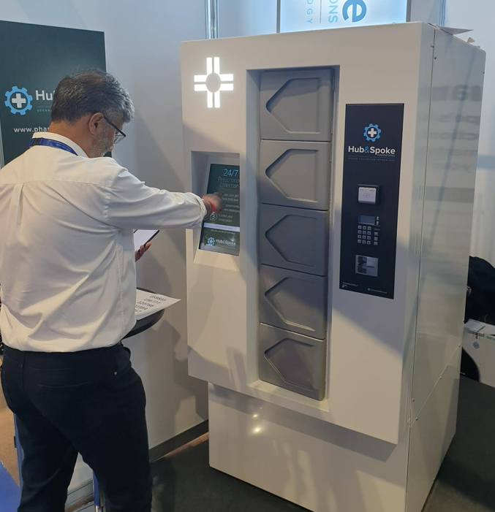
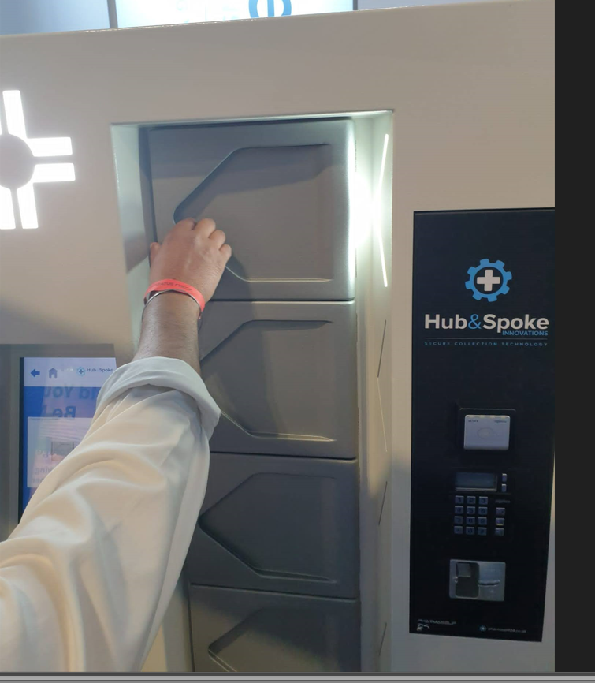
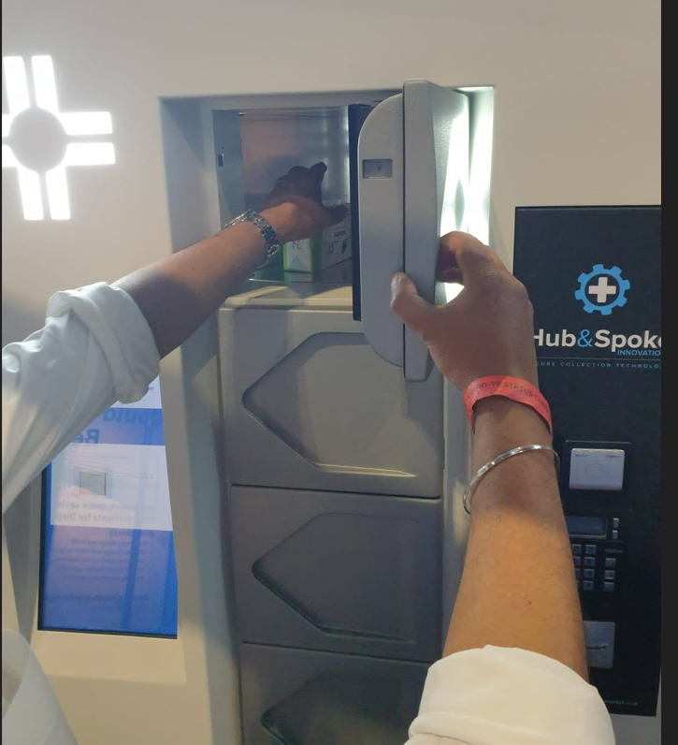
Patient experience

Slide 7
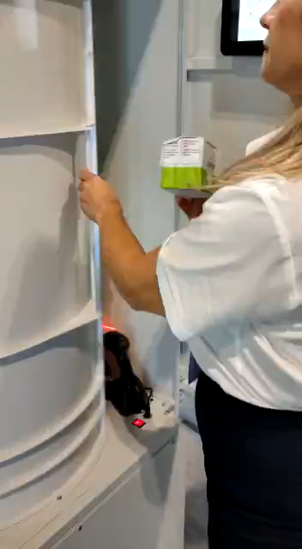
Restocking the machine
Barcode on medication scanned
Barcode on machine scanned

Slide 8
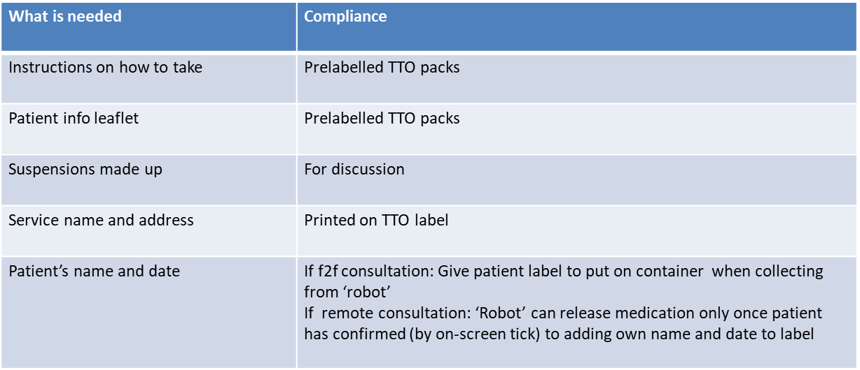
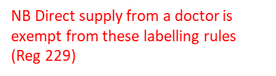
Legalities of Medicines Act – working with CPhOs, MRHA and GPhC to address
Supply of medicines | Medicines guidance | BNFC | NICE

Slide 9
Proposed Study Sites
Scotland
Unstaffed OOH base in community hospital serving area of major deprivation
No local community pharmacy provision OOH
OOH cars regularly diverted to deliver medication
Wales
Rural area
No community pharmacy provision after 5pm Mon-Sat or on Sundays
Up to 3 hour round trip for patients to collect medication following telephone call

Slide 10
Timetable
May 2023: Software development begins
Summer 2023: Testing of vending machine
Sept 2023: Scottish site goes live, data collection starts
Nov 2023: Welsh site goes live, data collection continues
Easter 2024: Initial results publicized
May 2024: Additional site recruitment begins

Slide 11

Evaluation

Slide 12


Other uses
Remote and island communities
Staffing challenges
Long travel times for patients to collect medication following an advice call
Emergency medicine supply solutions may impact on confidentially
Repeat medications coming in by ferry

Slide 13
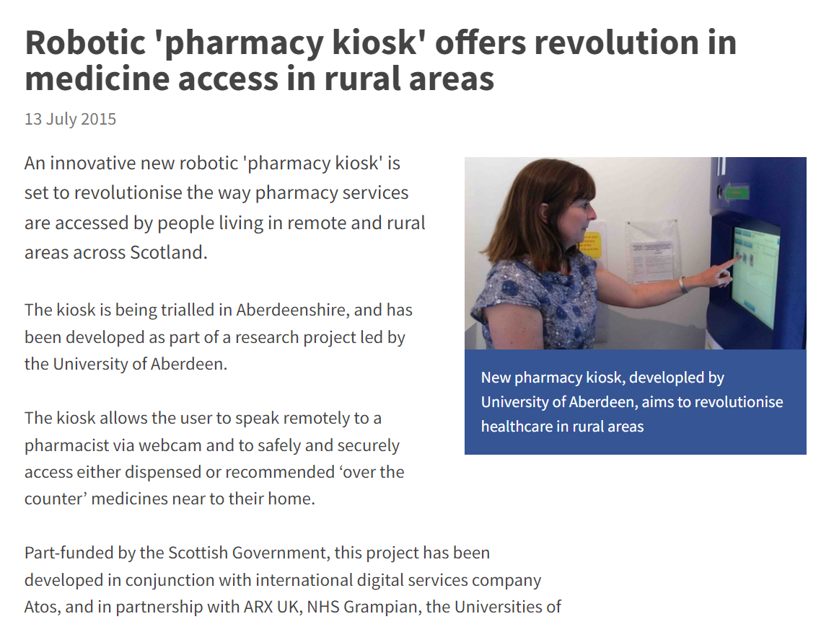
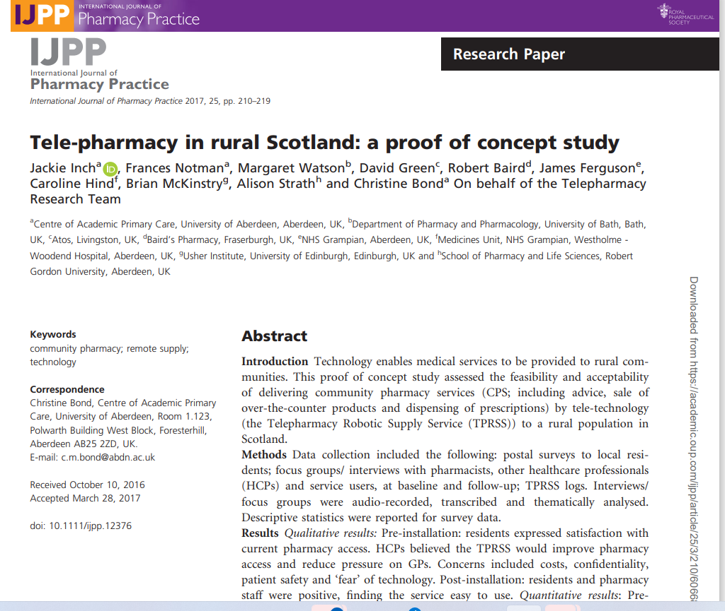
Similar concepts

Slide 14
Methods
Pre-Kiosk Installation | Kiosk in use | Follow up
Patient/user focus group (target 8) Patient/user questionnaire (target 150) Professional /stakeholder interviews NHS Grampian pharmacist focus group | Kiosk registering interactions | Patient/user questionnaire (target 100) Patient/user interviews (target 20) Professional /stakeholder follow up interviews
Notes:
Patient User Focus Group- poster on display
Patient user questionnaire – results reported here
Professional stakeholder interviews
staff from the 'base' pharmacy and the remote site (n=10),
local GPs (n=10)
local practice/district nurses (n=10);

Slide 15
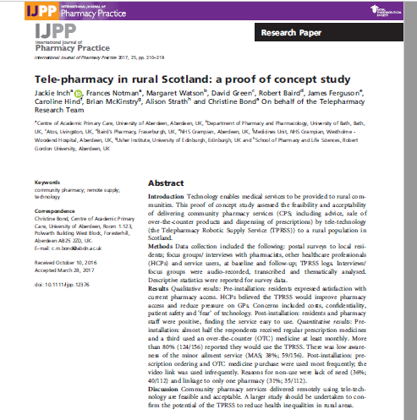
Main findings
  All stakeholders thought this was a good idea
  Residents would use the services
  Uptake less than expected but where used satisfaction was high
  Adverse incidents due to technology
Conclusion
  Community pharmacy services delivered remotely using tele-technology are feasible and acceptable. A larger study should be undertaken to confirm the potential of the TPRSS to reduce health inequalities in rural areas.

Slide 16
FAQs
Can I buy a vending machine?
Not yet please! We want to check it works first!!!
Can I be a pilot site?
Round 1 recruitment complete, round 2 begins May 2024 (subject to successful round 1)
How much does it cost?
Circa 20k for machine, £165/month service fee, plus contribution towards evaluation (site specific)
Can I be kept informed?
Email Rebecca.payne@phc.ox.ac.uk to be added to the newsletter circulation

